Slide 1


Management of American Indian Investment Decisions:
Fiduciary Liability & Risk Mitigation Considerations
Inspiring Leadership, Stewardship and Governance
Notes:
Independent RIA
Fiduciary 3(21) or 3(38)
Created something special
Very proud of
Focused on improving participant outcomes
Help you think, think through
Understand your needs
THOUGHT LEADERSHIP
Partner
Expand your in house competence
DO YOU HAVE AN ACTIVE PARTICIPANT OUTCOME STRATEGY?
WHAT ARE YOU MOST PROUD ABOUT YOUR PLAN?
Notes from FINRA: Member Firm’s name must be prominently identified in the final version. Please insert your logo at the top of this slide and on the footer of all slides to meet this requirement. You must insert your securities information on the front page as well (see final line of text on this slide to customize).

Slide 2
Table of Contents
Introduction …………………………………………………………………………...……. Slide 3
Suitability vs Fiduciary Standard Checklist ...……………………….…..……. Slide 6
Checks and Balances …………………………………………………………………….. Slide 8
Service Provider Roles and Responsibilities ……………………................ Slide 9
With or Without an Investment Management Consultant .…………… Slide 11
Investment Policy Statement ………………………………………………………… Slide 13
Investment Management Consultant Process……………………………….. Slide 14
Advanced Portfolio Construction ……..............................………………… Slide 15
Asset / Liability Investing ………………………………………………………………. Slide 17
Investment Manager Selection and Monitoring ……………………………. Slide 20
Fiduciary Best Practices ………………………………….…………………………….. Slide 21

Slide 3
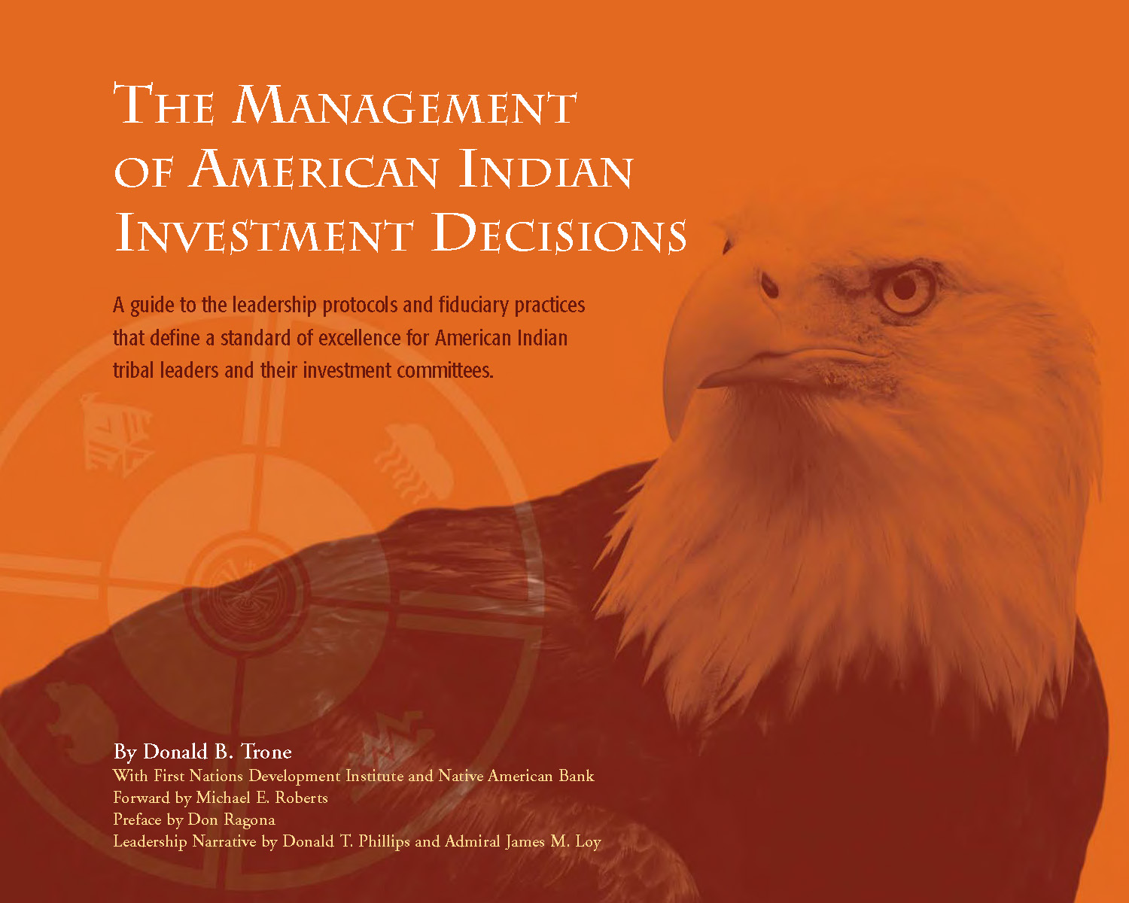
Introduction
Notes:
We have the resources to provide you a TOTAL BENEFIT SOLUTION
DEPTH OF RESOURCES
Strength of Organization
If we don’t have the answer we have the resources……….
Including a former practicing ERISA attorney
Health Care – Cost, Compliance, Communication
Executive compensation & financial planning
Pension

Slide 4
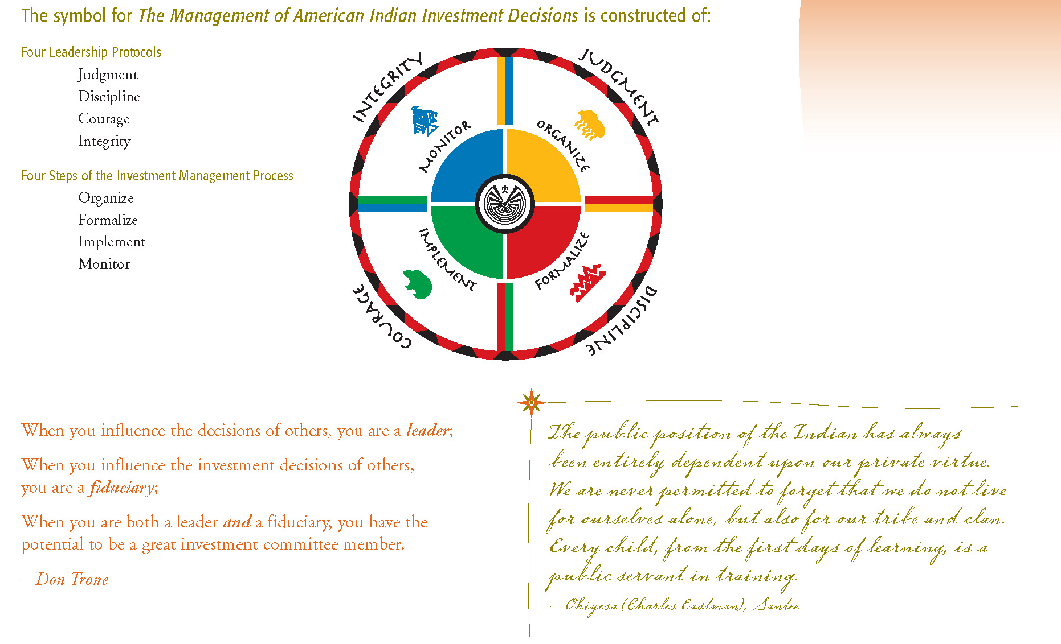
Introduction
Notes:
We have the resources to provide you a TOTAL BENEFIT SOLUTION
DEPTH OF RESOURCES
Strength of Organization
If we don’t have the answer we have the resources……….
Including a former practicing ERISA attorney
Health Care – Cost, Compliance, Communication
Executive compensation & financial planning
Pension

Slide 5
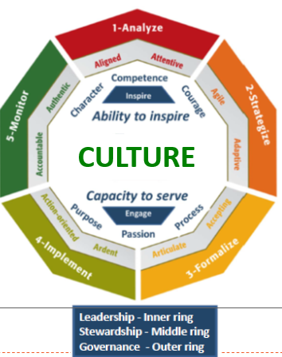
LeaderMetrics™ Ethos

Slide 6
Suitability vs. Fiduciary Standard Checklist
FIDUCIARY CHECKLIST
Bank/Broker-Dealer
Suitability Standard
Registered Investment Adviser (RIA)
Fiduciary Standard
Conflicts of Interest:
Proprietary Product Trading (internal profit desks)
Principal Trading (allowed in managed accounts)
Manufacturing / Distribution mark-up
Securities / Product Mark-ups
Distribution Channel Mark-ups
ERISA 3(21) or 3(38) Fiduciary Status
Yes – possible conflicts*
Yes – possible conflicts*
Yes – possible conflicts
Yes – possible conflicts
Yes – possible conflicts
Yes – possible conflicts
Limited – possible conflicts
No
No
No
No
No
No
No
* Bank Trusts may serve as a fiduciary trustee. However, their introduction of proprietary product and selling clients securities with hidden mark-ups on a principle (from bank or broker securities inventory) or an agency basis have obvious “conflicts of interest” and may often be conducted in an undisclosed manner – Caveat Emptor (buyer beware).

Slide 7
Fully Open vs. Broker/Dealer Closed Platform
Custody
Trust Services
Lending
Mkt/Econ
Data
Investment Research
Portfolio Admin
Technology Infrastructure
Portfolio
Evaluation Reporting
Risk Management Analysis
RIA Fiduciary standard
B-D Suitability Standard
Fiduciary Law (RIA 40 Act)
Client’s Best Interest (by Law)
Full Transparency/Fee Disclosure
Suitability (May conflict w/Client’s best interest)
B-D/Shareholders 1st
“Wrap-fee” and/or Hidden feed
  12b-1 fees
  Shelf-space/Pay to Play arrangements
Product Manufacturers & Distribution
Multiple Masters
Institutional Sales
Analyst Research [Big/Small]
Investment Banking
$ Distribution/Sales Desk
$ Broken Sales Force
$ Retail Client Pricing
$ Private Client Group
Advisory Services
Goal Centric
A/L Modeling
Ø Balance Sheet Risk
Ø Proprietary Trading
Ø Proprietary Product
Asset Mgt.
$ Institutional Pricing
Business Model Comparison

Slide 8

Checks and Balances: Separation of Services
Without the separation of services is like having the fox guard the hen house
Independent Investment Products
(Money Managers)
Registered
Investment
Investor
Custodian
(Asset Protection
and Reporting)
Adviser
Bank/Broker-Dealer
Trade Executions
(No Principal Trades)
Fiduciary Best Practice:
Service Providers should be separate and independent to provide for a system of checks and balances.
Money Managers and Trust Companies should be independent of any other Service Providers.
Investment Management Consultant/RIA oversight as an Independent Fiduciary mitigates conflicts of interest.

Slide 9
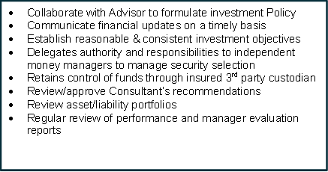
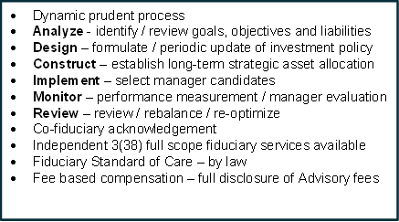
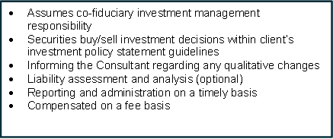
Investor / Investment Management Consultant / Money Manager
Roles and Responsibilities
Investor
Investment Management Consultant (IMC)
Independent Money Managers
Custodian and/or
Trust Company
Trustee Administration
Custodial Statements
Paying Agent Services

Slide 10
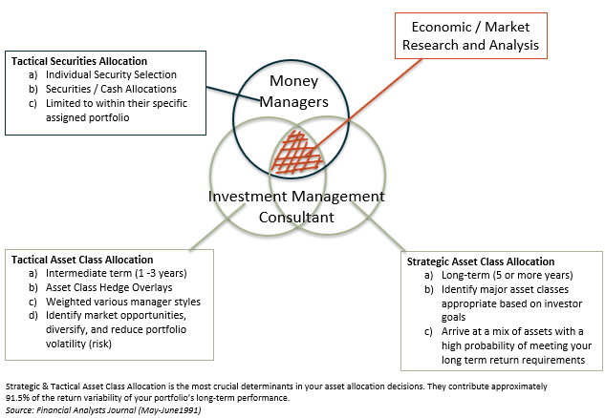
Investment Management Consultant vs. Money Manager
Investment Decisions

Slide 11
Without or With an Investment Management Consultant (IMC) Comparison
Without IMC
Investment Policy Development
With IMC
Biased - Written by manager, to fit manager’s style. Possibly not the best suited for the investor's profile. Definitely not appropriate for the total portfolio.
Unbiased – objectively written in client’s best interest. Tailored to fit client.
Asset Allocation
Limited Economic research focusing on sector allocations and security selection. Typically, conflicted from recommending other Non-Affiliated money managers.
Robust Advisers open-source resources are the broadest commitment of its kind to capital markets analysis asset allocation advice, manager research and performance monitoring.
Manager Selection
Asset Management Without IAC
Asset Management With IAC
Essential to realize efficient and effective asset selection.
Limited to signature style of the manager.
Unlimited. Investor as access to vast universe of all Registered Investment Advisers (RIAs), Banks, and Insurance companies. This provides greater selection (diversification) among managers with further specialization in specific market segments.
Active/Passive Allocation Blend
Our multi screening process identifies some of the most promising independent active managers for each sub-asset class. The search process incorporates both quantitative and qualitative criteria and draws on vast expertise of multi-providers. Passive indexing used to budget active management risk.
Not Available.

Slide 12
Operating Without or With an Investment Management Consultant (IMC) Comparison
Without IMC
Manager Evaluation/Ongoing Due Diligence
With IMC
Self evaluation may inhibit critique, which may lead to a “fox guarding the henhouse” conflict of interest.
Objective third-party evaluation and continuous due diligence for selection as well as selection/retention decision making information
Performance Measurement/Attribution Analysis
Objective performance measurement/analysis leads to a better understanding for tracking an investors progress through risk adjusted return, universe/peer ranking and comparative analysis. Creates a “watch dog” arrangement to facilitate keeping investors accurately informed.
Self performance measurement and analysis is a self report card system. Has potential of leaving out important decision-making information and comparative analysis.
Trade Executions
Asset Management Without IMC
Asset Management With IMC
Discount brokerage in many cases may lead to inferior execution of transactions in the form of larger price spreads and markups/markdowns and inefficient untimely execution at critical junctures.
No commissions provide best execution possible and eliminates conflicts of interest which may be presented in commission-based arrangements. advisors employs an un-conflicted supporting infrastructure which permits managers to trade away in the client’s best interest.
Cost Comparison
Usually higher management fee schedules outside pre-negotiated Advisors negotiated platforms.
Pre-negotiated/discounted regressive management fees available in an all-inclusive arrangement. Consulting fees may be less than brokerage commissions.

Slide 13


Investment Policy Statement
An institutional process which is comprehensive, independent, and a well-documented methodology to provide continuity.
Powered by
Quantitative
Metrics
Investment
Universe
(20,000+ investments)
Investment
Policy
Statement
=
Investment Menu
+
Qualitative
Metrics

Slide 14
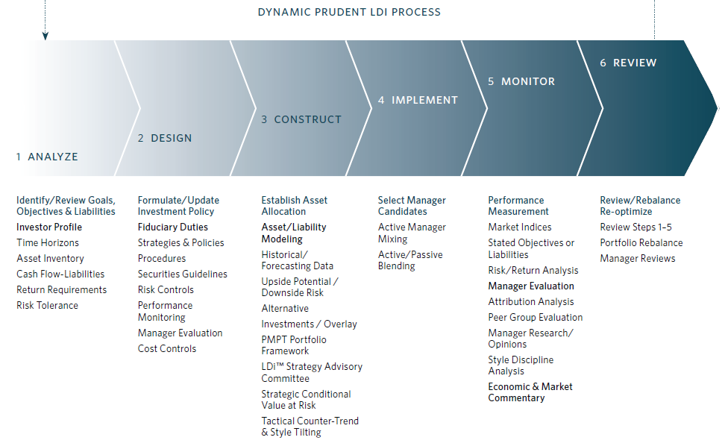
Investment Management Consultant Process

Slide 15
Advanced Portfolio Construction
Understanding what’s Under the Hood
1950’s Technology – MPT Limitations
  Standard Deviation vs. Conditional Value at Risk Framework
  Mean Variance vs. Upside Potential / Downside Risk Optimization
Asset Allocation Corruption
  Style Overlap
  Traditional Stock-Picking vs. Multi-Factor Dimensions
PMPT Solution
  Conditional Value at Risk (CVaR)
  Upside Potential/Downside Risk

Slide 16
Modern Portfolio Theory Limitations - Solutions
Considerations | Modern Portfolio Theory | Post-Modern Portfolio Theory
Investment Beliefs | Investors cannot beat the “market” | Beating the “market” is irrelevant
Volatility | All volatility is bad, whether upside or downside | Downside volatility is bad while upside volatility is good
Basis of Investor Decisions | Mean return and standard deviation | Helps Identify the Investor’s target return, linking today’s asset position to future liability goals
Investment Objective | Maximize expected rate of return for a given level of risk | Maximize the potential to meet or exceed the investor’s LDindex relative to the risk of falling below the target return
Active vs. Passive | Active management cannot add value | An optimal blend of active and passive management should outperform a portfolio of purely passive managers
Current Financial Status | Not considered | Essential consideration
Future Financial Needs | Not considered | Essential consideration
Risk | Volatility | Achieving Investor’s Target Return (actuarial assumption)

Slide 17
Asset / Liability Investing Approach: Liability Driven Investing (LDI)
Addressing Different Portfolio Needs
Investor A
Financial Goal:$1,100,000 annually
ASSETS: $16,000,000
Investor B
Financial Goal:$1,100,000 annually
ASSETS: $10,000,000
Defensive Capital Preservation
Maximum Capital Appreciation
Target Return 3%
Capital Appreciation / Income
Target Return 8%
Equity Target 15%
Target Return 5%
Equity Target 90%
Equity Range 5-35%
Purchasing Power Preservation
Equity Range 75-95%
Equity Target 60%
Capital Appreciation
Target Return 4%
Equity Range 45-75%
Target Return 7%
Equity Target 75%
Equity Target 40%
Equity Target 75%
Equity Range 25-55%
Equity Range 65-85%
Sample: Illustration Purposes Only
Allocation Ranges Will Vary Dependent Upon Capital Market Conditions

Slide 18
Asset / Liability Investing: Risk and Return Tradeoff
8
7
Approximate Time Frame of Investment (in years)
RETURN
5
Increasing Risk/Increasing Return Expectation
4
RISK
3
Target Return 3-4% (Conservative)
Target Return 5-7% (Moderate)
Target Return 8% (Growth)
income oriented
moderate capital growth
high capital growth
capital preservation oriented
minimal income needs
greater volatility possible
suitable for short time horizon
longer time horizon possible

Slide 19
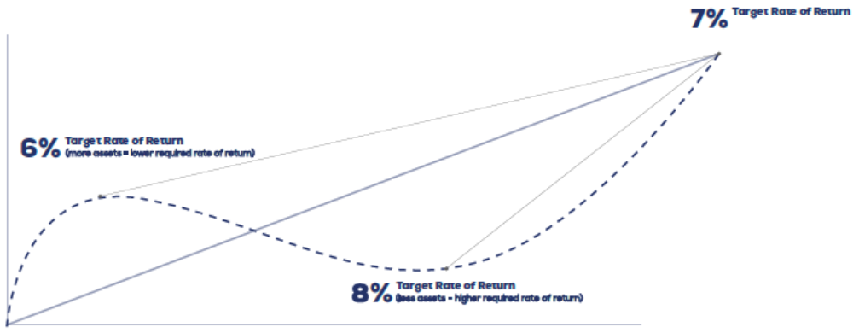
Asset / Liability Investing (LDI) Management
LDI Target Return Adjustments
Asset Appreciation Lowers the LDI Target Return
Asset Depreciation Raises the LDI Target Return

Slide 20
Investment Manager Selection and Monitoring
  Manager ranking evaluates investments on a scale such as 0 to 10 in core asset classes, including asset allocation investments.
Qualitative Factors
Quantitative Factors
30%
Style Factors
30% Risk/Return
Factors
20% Peer Group Ranking
20% Qualitative Ranking
1. Style Analysis
2. Style Drift
3. R-Squared
4. Risk/Return
5. Up/Down Capture
6. Information Ratio
7. Returns
8. Information Ratio
9 &10. Awarded for factors as Manager Tenure
and fund expenses, among other criteria

Slide 21
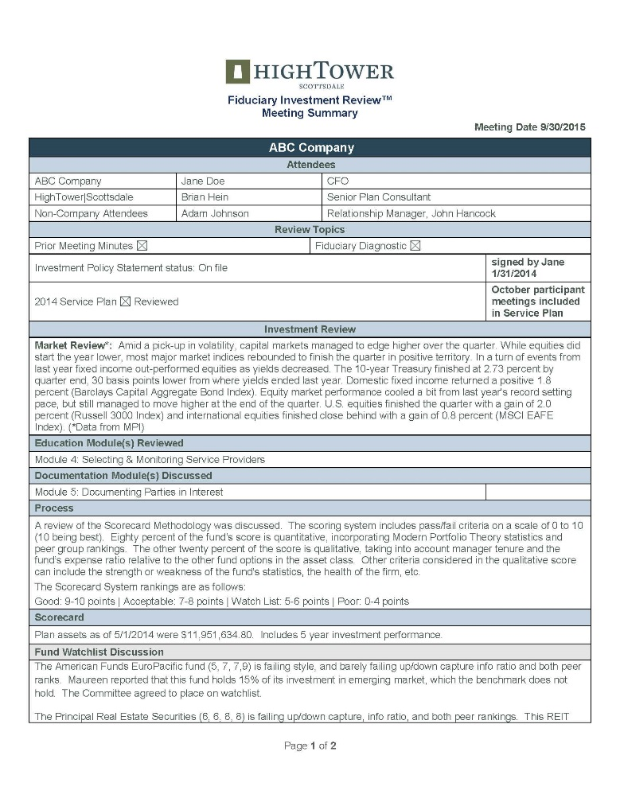


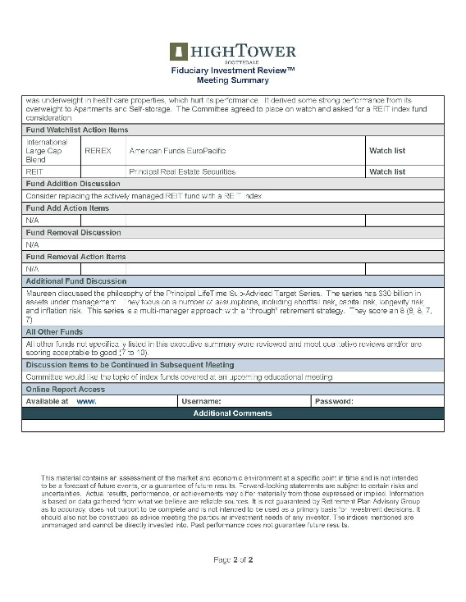
Fiduciary Best Practices
Documenting the process:
Investment committee charter
Investment policy statement
Investment monitoring reports
Service Provider due diligence & monitoring
Fiduciary compliance file
Meeting minutes
Facilitated by your IMC
Notes:
Meeting Minutes

Slide 22
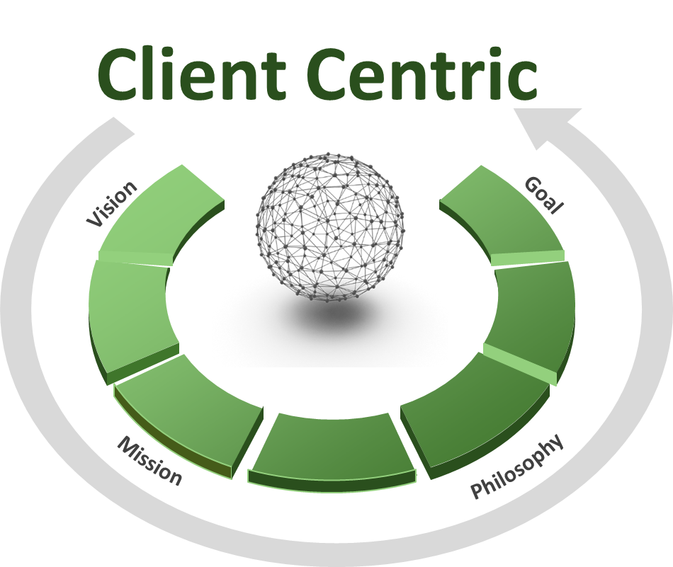
Evolution of a Revolution
Notes:
Meeting Minutes

Slide 23
Disclaimer
Advisory services offered through NewEdge Advisors, LLC, a registered investment adviser.
THIS PRESENTATION IS FOR INFORMATION AND DISCUSSION PURPOSES ONLY, AND IS NOT AN OFFER TO SELL OR A SOLICITATION OF OFFERS TO BUY SECURITIES OR TO MAKE ANY INVESTMENT DECISION OF ANY TYPE. THE INFORMATION IN THIS PRESENTATION IS INTENDED FOR ILLUSTRATIVE AND DISCUSSION PURPOSES ONLY, AND IS NOT TO BE RELIED UPON FOR ANY INVESTMENT DECISION OR FOR ANY OTHER PURPOSE. THIS PRESENTATION HAS NOT BEEN FILED WITH OR APPROVED BY ANY SECURITIES AUTHORITY NOR HAS ANY SUCH AUTHORITY PASSED UPON THE ACCURACY OR ADEQUACY OF THIS PRESENTATION OR ANY INTEREST IN THE COMPANY.
THE COMPANY MAKES NO EXPRESS OR IMPLIED REPRESENTATION OR WARRANTY AS TO THE ACCURACY OR COMPLETENESS OF THIS PRESENTATION. THIS PRESENTATION IS COMPRISED LARGELY OF FORWARD-LOOKING STATEMENTS AND INFORMATION THAT IS BASED ON THE BELIEFS OF THE COMPANY’S MANAGEMENT BASED ON INFORMATION CURRENTLY AVAILABLE. FORWARD LOOKING STATEMENTS INVOLVE RISKS AND UNCERTAINTIES THAT COULD CAUSE ACTUAL RESULTS, PERFORMANCE AND RETURNS TO DIFFER MATERIALLY FROM THE RESULTS PRESENTED IN THIS DOCUMENT, DUE TO A VARIETY OF FACTORS, RISKS AND UNCERTAINTIES, REGARDLESS OF WHETHER KNOWN OR NOT KNOWN TO US. EVEN IF THE RESULTS AND DEVELOPMENTS IN THIS PRESENTATION ARE REALIZED IN WHOLE OR IN PART, THERE IS NO ASSURANCE THAT THEY WILL HAVE THE EXPECTED CONSEQUENCES OR EFFECTS ON THE COMPANY OR ITS CONSTITUENTS. THIS PRESENTATION SPEAKS ONLY AS OF ITS ORIGINAL DATE OF PREPARATION AND DOES NOT PURPORT TO BE ALL THE INFORMATION AN INTERESTED PARTY MAY REQUIRE IN ORDER TO EVALUATE AN INVESTMENT IN OR OTHER RELATIONSHIP WITH THE COMPANY.
THIS PRESENTATION HAS BEEN SUBMITTED ON A CONFIDENTIAL BASIS TO YOU BASED ON YOUR QUALIFICATIONS AND YOUR EXPRESSED INTEREST IN LEARNING MORE ABOUT THE COMPANY AND SERVICES PRESENTED. YOU MAY NOT REPRODUCE, USE OR COPY THIS PRESENTATION IN ANY MANNER WITHOUT THE PRIOR WRITTEN CONSENT OF THE COMPANY. BY ACCEPTING THIS PRESENTATION, YOU AGREE TO HOLD THE INFORMATION IN STRICT CONFIDENCE AND WILL NOT USE ANY OF INFORMATION TO THE DETRIMENT OF THE COMPANY.
S:\Shared With Me\401(k) - Plan Services\Marketing, Presentation, Logos\Marketing-401k Presentations
Notes:
TPSU
TRAU - Certified 401(k) Specialist
Membership has it’s privileges – Advisory Board - Chatter Membership

