Slide 1
Safety Gap Model
General Safety in Schools – Back to Basics
The 5 D’s of Safety

Slide 2
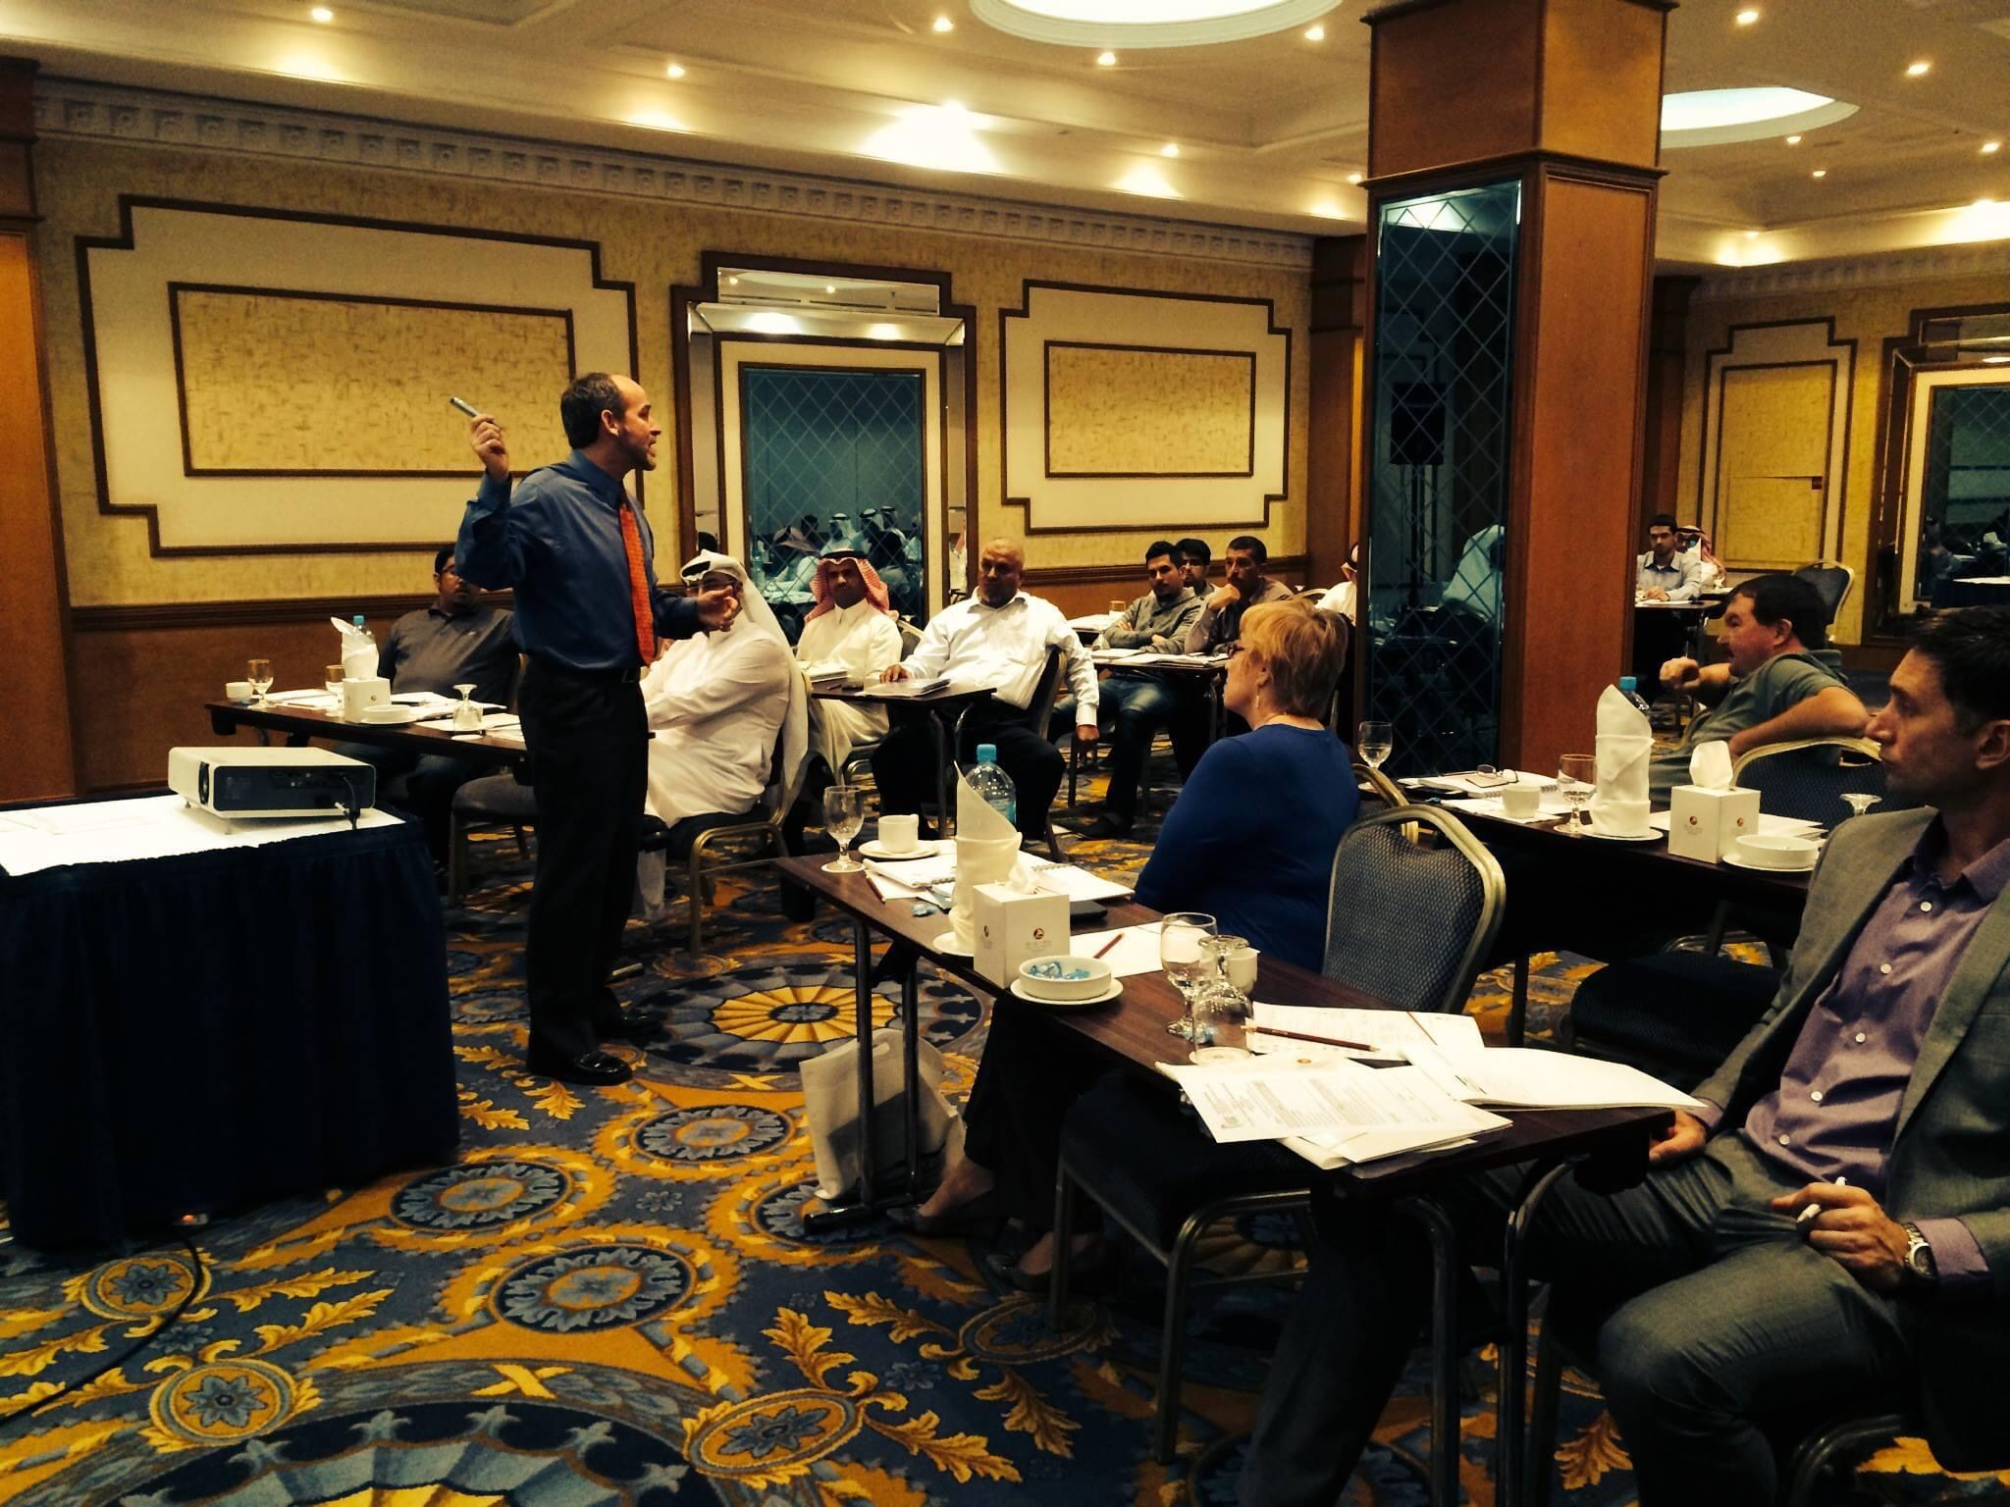
Two-day workshop
Middle East Safety Conference
Bahrain
5Ds of Safety

Slide 3
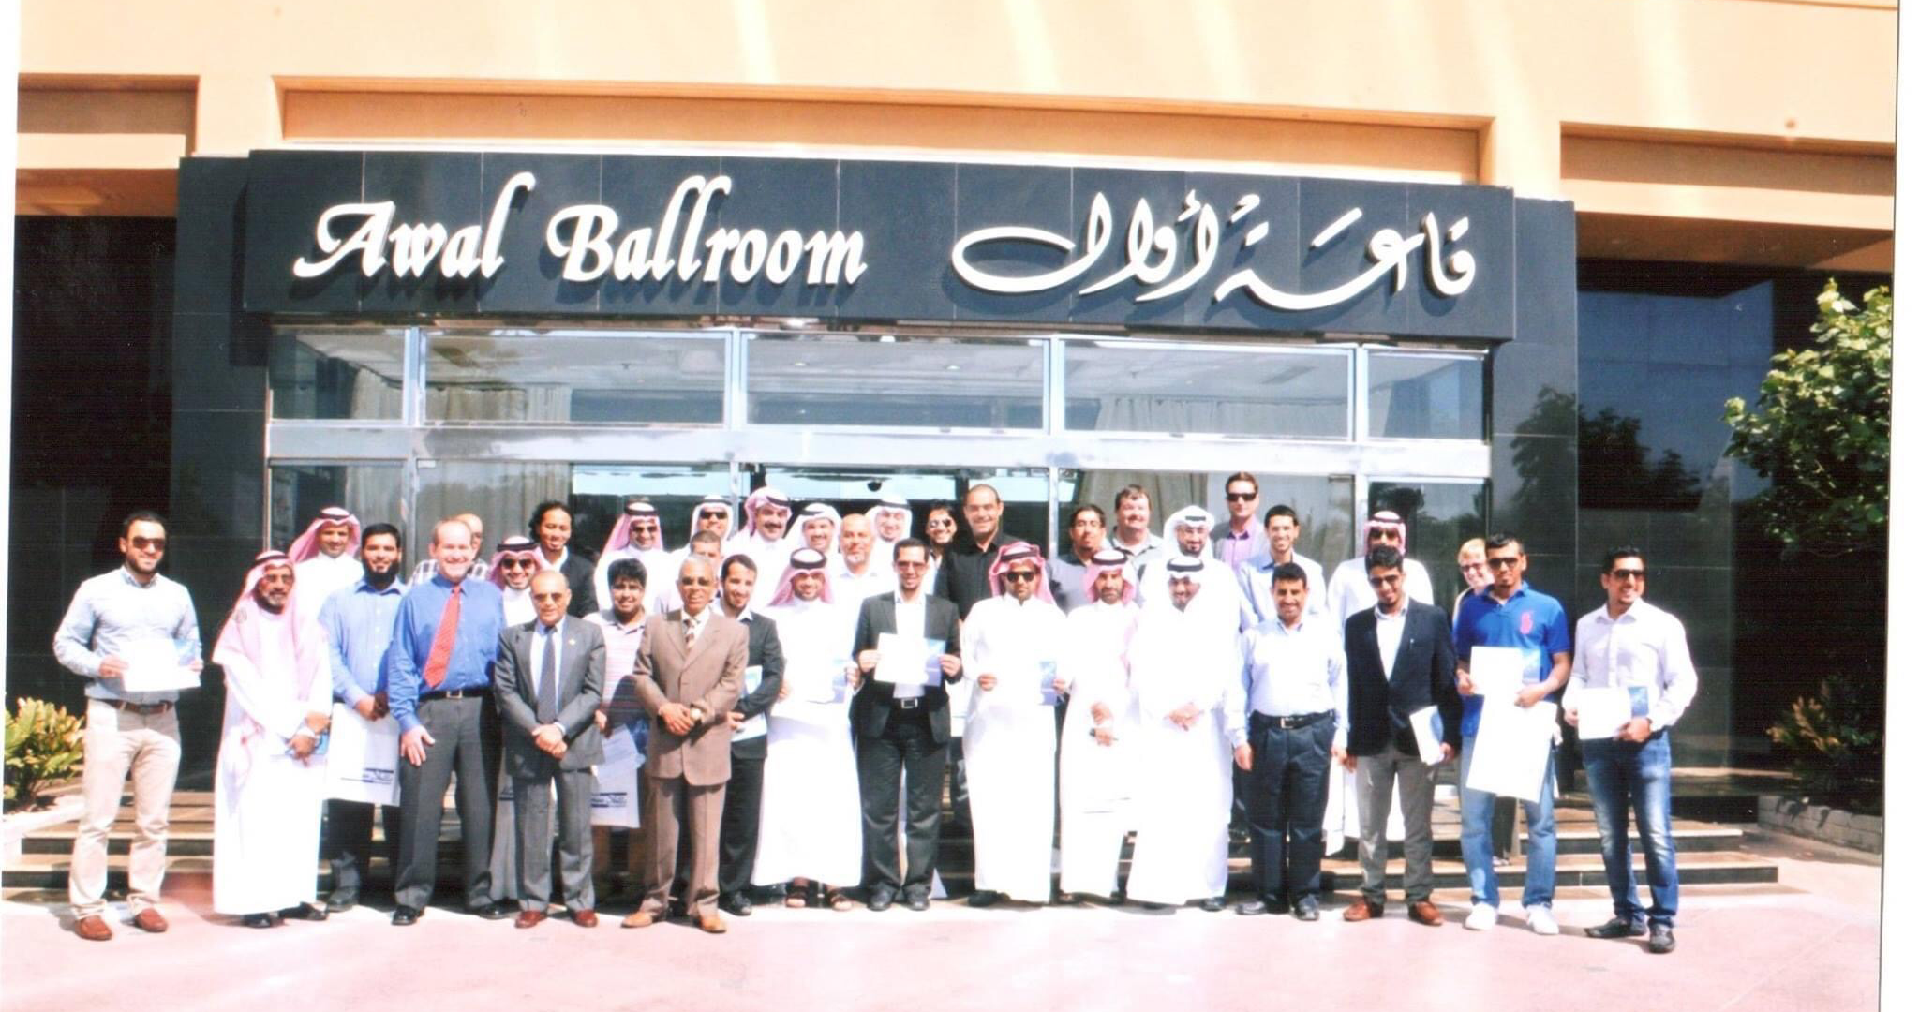

Slide 4
Safety Gap Model
Documented Hazards
Documented Policies
Documented Trainings
Documented Inspections
Documented Accountability

Slide 5
How we use the Safety Gap Model
Awareness gap
Process gap
Knowledge gap
Verification gap
Accountability gap
Document Accountability
Document Job Hazards
Document Inspections
Document Policies
Document Training
Notes:
When each of the 5 gaps are addressed, companies will have a positive safety culture. If there is a “weak link” or gap that isn’t addressed, the company safety culture can’t be strong. By addressing all safety gaps in the Safety Gap Model with a safety gap analysis, companies minimize their business risk as it applies to safety and insurance.
Each slide needs to have:
Name of gap
Definition of gap
Symptoms / what do you see?
What is the solution?
Case study / example / story
Each gap will have:
Questions that are asked (Nat)
Checklist templates (Nat)
Short guide to…

Slide 6
Awareness gap
The awareness gap is the difference between the availability of safety information and the school’s awareness (or knowledge) of safety.
Essentially, this gap arises because the company doesn’t know exactly what hazards exist and they aren’t familiar with regulations or other safety information.
Why does this gap exist:
Lack of communication between BIE and school.
Insufficient safety research on behalf of school.
Failure to read/listen to OSHA regulations.
What are the symptoms:
Lots of accidents (OSHA’s TRIR)
Lack safety practices (not wearking PPE or following the necessary guidelines)
Solution:
Awareness gap
Process gap
Knowledge gap
Verification gap
Accountability gap
Document Job Hazards
Notes:
Symptoms:
Lots of accidents (OSHA’s TRIR)
Lack safety practices (not wearking PPE or following the necessary guidelines)
Incidents that don’t have a written policy
Examples/stories:
Torch story for Plumbing
Weather Master High EMOD
Excavation fatality – now safety trainer did not have the right awareness gap and it caused the fatality with his employee
Jitu Story “I do not care about OSHA, I care about safety” Jitu risked his life to defy the King of Saudi Arabia to protect his employees.

Slide 7
Process Gap
The process gap is the difference between a company’s understanding of their safety needs/mandated regulations, and the translation of that understanding into safety policies and standards.
Why does this gap exist:
Lack of defined responsibility
Poorly defined safety processes.
Failure to regularly update safety process standards.
What are the symptoms:
Solution:
Process gap
Knowledge gap
Verification gap
Accountability gap
Awareness gap
Document Policies
Notes:
Return to Work Program examples
We are aware that this is a problem, but we don’t have it in place at this time.
Symptoms:
Irish Roofing/ OSHA Fine
Metro Fire – ISNET World Manual creation
Fondomonte example: There was nothing wrong with the documentation and we were able to reduce the fine for loss of leg.
Washington Employer sentenced to manslaughter – process gap and the failure caused this fatality
Mandated Regulations:
DOT
OSHA
EPA
Insurance Regulations
Policies and regulations protect the company. 75% of a policy is what Insurance, OSHA, DOT and other entities want to see. The rest is to protect the employees.

Slide 8
Knowledge gap
The knowledge gap is the difference between safety policies and standards and the knowing how to implement them.
Why does this gap exist?
Lack of training.
Employee lack of safety knowledge
Lack of defined responsibility
What are the symptoms?
Lack of training for foreman and supervisors
Lack of training new hires
Employees unsure of company policies
OSHA fines
Solution:
Process gap
Knowledge gap
Verification gap
Accountability gap
Awareness gap
Document Training
Notes:
Note for Celeste: Performance is not always indicative if they do not have a safety culture.
Can it be reworded to cover the knowledge and understanding and performance of such practices.
Symptoms:
Lack of training for foreman and supervisors
Lack of training new hires
Employees unsure of company policies
OSHA fines
Teaching of work is not always paired with safety (teaching them how to use the hammer and then teaching how to use it safely. Do it at the same time!)
Tow truck driver caused damage to his vehicle due to lack of safety training and tried to tow two vehicles
https://www.osha.gov/news/newsreleases/region5/02162016 – lack of training lead to fatality on the job

Slide 9
Verification gap
The verification gap is the difference between safety training provided and safety behavior.
Why does this gap exist?
Employees misinterpret the importance of safety
Lack of safety supervision
Company focus on productivity over safety
Safety not recognized as a company goal
What are the symptoms?
Productivity valued at expense of safety
Company feel unable to enforce safety
Company unsure of how to prevent accidents or where to start (inspections can find the trends)
Solution:
Awareness gap
Process gap
Knowledge gap
Verification gap
Accountability gap
Document Inspections
Notes:
Verification
Productivity needs to be paired with safety
Symptoms:
Company feel unable to enforce safety
Company unsure of how to prevent accidnets or where to start (inspections can find the trends)
Stories:
IC first fataility was with a Forklift training. The company asked what else could be done and OSHA said they did not inspect.

Slide 10
Accountability gap
The accountability gap is the gap between safety behavior and recognizing and addressing the behavior. This leads to a lack of accountability or repercussions.
Why does this gap exist?
Safety not part of leadership goals
Lack of defined bad performance process
Lip service to safety
What are the symptoms?
Lack of top down accountability
Low company moral
Solution:
Awareness Gap
Process Gap
Knowledge Gap
Verification Gap
Accountability Gap
Document Accountability
Notes:
It also includes not appropriately recognizing wanted behavior.
Symptoms:
Lack of top down accountability
Low company moral
https://www.safetysolutions.net.au/content/business/article/ways-to-boost-workplace-morale-through-safety-91826895#:~:text=Educating%20workers%20about%20the%20company's,in%20the%20workplace%20and%20morale.&text=Providing%20employees%20with%20the%20tools,morale%20by%20showing%20employer%20commitment.
Fondomonte loss of legs due to the accountability gap
Add to the audit reports:
Percentage grade overall
Grade per gap
Streamline this with Newmark

Slide 11
Questions?

