Slide 1


Retirement Plan Fiduciary Considerations
Inspiring Leadership, Stewardship and Governance
Notes:
Independent RIA
Fiduciary 3(21) or 3(38)
Created something special
Very proud of
Focused on improving participant outcomes
Help you think, think through
Understand your needs
THOUGHT LEADERSHIP
Partner
Expand your in house competence
DO YOU HAVE AN ACTIVE PARTICIPANT OUTCOME STRATEGY?
WHAT ARE YOU MOST PROUD ABOUT YOUR PLAN?
Notes from FINRA: Member Firm’s name must be prominently identified in the final version. Please insert your logo at the top of this slide and on the footer of all slides to meet this requirement. You must insert your securities information on the front page as well (see final line of text on this slide to customize).

Slide 2
Table of Contents
Introduction…………………………………………………………………………...……. Slide 3
ERISA 3(21) versus 3(38) Fiduciary……………...……………………….…..…. Slide 7
Plan Sponsor Fiduciary Compliance……………………………………........... Slide 11
Investment Analysis………………………………..……………………………………. Slide 22
Investment Implementation…………………..…………………………………… Slide 31
Education and Communication……..……………………………………………. Slide41
Fee Benchmarking and Vendor Searches……..............................….. Slide 48
Summary / Closing………………………………………………………………………. Slide 54

Slide 3

Introduction
Notes:
We have the resources to provide you a TOTAL BENEFIT SOLUTION
DEPTH OF RESOURCES
Strength of Organization
If we don’t have the answer we have the resources……….
Including a former practicing ERISA attorney
Health Care – Cost, Compliance, Communication
Executive compensation & financial planning
Pension

Slide 4
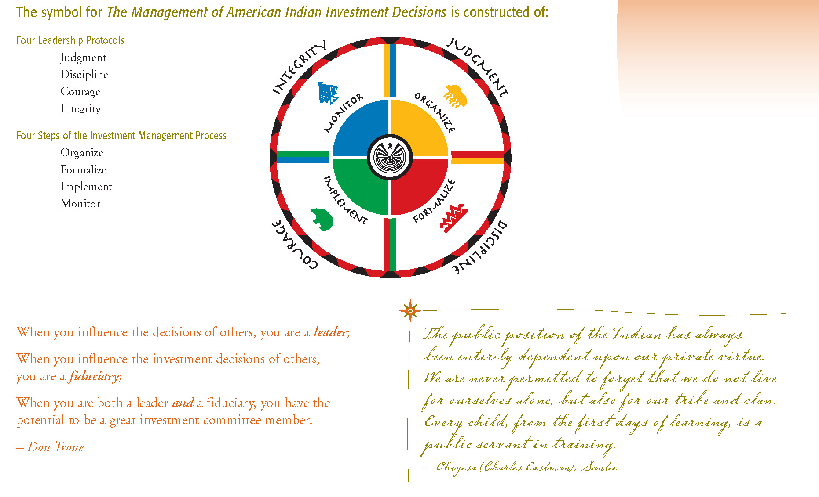
Introduction
Notes:
We have the resources to provide you a TOTAL BENEFIT SOLUTION
DEPTH OF RESOURCES
Strength of Organization
If we don’t have the answer we have the resources……….
Including a former practicing ERISA attorney
Health Care – Cost, Compliance, Communication
Executive compensation & financial planning
Pension

Slide 5
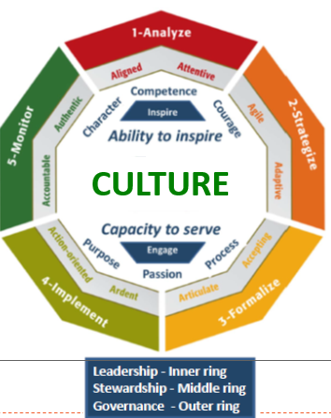
LeaderMetrics™ Ethos

Slide 6
3 Key Fiduciary Considerations: Hiring Plan Providers
Experience:
LDI Advisers is a Retirement Plan Advisory Group™ (RPAG) member firm – representing over $500 Billion in qualified plan assets.
RPAG - one of the nation’s largest integrated practice management solutions, providing systems, technology and resources to create successful retirement plan outcomes.
We serve the needs of Plan Sponsors, their Leadership and Employees (Participants) to facilitate fiduciary duties within their distinct regulatory circumstances.
TRAU / TPSU – The Retirement Advisors University/The Plan Sponsor University
  Certified 401k Professional C(k)P) designation.
  TPSU – Arizona Adjunct Lecture (since inception).
Unbiased:
Fully open architecture with access to high quality, resources, recordkeepers, custodians, etc.
Consultative process to assist with effectively and efficiently operating your retirement plan.
Intelligible Resources:
Robust technology, systems and services.
Provide Plan Sponsors and Participants comprehensive & understandable retirement plan resources.
iJoin Technology Platform Innovator – ENROLL, ACT, EXPLORE, MAP
Notes:
We have the resources to provide you a TOTAL BENEFIT SOLUTION
DEPTH OF RESOURCES
Strength of Organization
If we don’t have the answer we have the resources……….
Including a former practicing ERISA attorney
Health Care – Cost, Compliance, Communication
Executive compensation & financial planning
Pension

Slide 7

Service Level Considerations:
Non-Fiduciary or
ERISA 3(21) versus 3(38) Fiduciary
Note: Delegating Fiduciary responsibility under ERISA Section 3(38) provides Plan Sponsors an extra layer of Fiduciary liability protection
Notes:
Fiduciary Concerns?
We can work with a 3(16) Fiduciary that can be the named fiduciary in the plan document
We can’t audit our work
Are you comfortable with what you current advisor is providing?
Do you have a process for monitoring your advisor?

Slide 8
3(21) vs 3(38) Fiduciary
3(21) Investment Fiduciary
  Advisor provides non-discretionary investment recommendations
  Plan Sponsor/Trustee retains ultimate decision-making authority (liability) for investment selection.
  Both Plan Sponsor & Advisor share the fiduciary responsibility.
3(38) Investment Fiduciary
  Investment Manager provides discretionary investment selections
  30-day notices still provided to Sponsor & Participants
  Plan Sponsor/trustee is relieved of all fiduciary responsibility for the investment decisions made by the investment manager professional.
This fiduciary responsibility shift is the key distinction and core advantage of using a 3(38) Investment Manager.
In ever-increasing litigation and heightened regulatory scrutiny, many plan sponsors want this extra layer of protection.

Slide 9
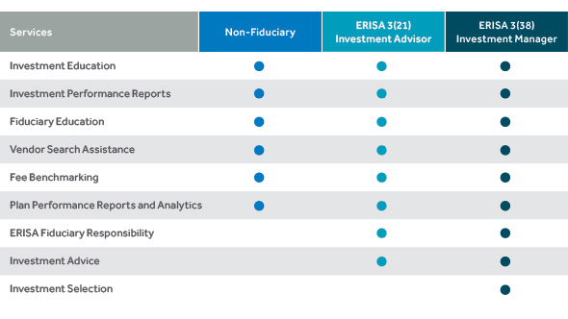
Fiduciary Roles
3(21) vs 3(38) Fiduciary Comparison
(Source) New York Life Blog: Insights, May 15, 2017

Slide 10
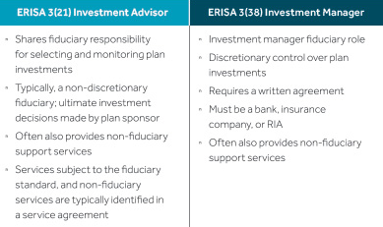
3(21) vs 3(38) Fiduciary
(Source) New York Life Blog: Insights, May 15, 2017

Slide 11
Plan Sponsor Fiduciary Compliance
CEOs, Presidents, CFOs and other fiduciaries have personal liability for assets in the company’s retirement plan.
It is crucial that plan sponsors partner with an independent firm specializing in services that reduce exposure to fiduciary liability.
Notes:
Fiduciary Concerns?
We can work with a 3(16) Fiduciary that can be the named fiduciary in the plan document
We can’t audit our work
Are you comfortable with what you current advisor is providing?
Do you have a process for monitoring your advisor?

Slide 12

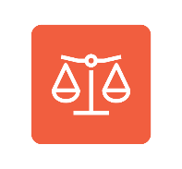




Service Model – Structure
Participant Outcomes
Fiduciary Compliance
Helping participants pursue retirement income potential
Core Fund & Target Date or Target Return Fund Selection
Providing assurance for fiduciaries
Investment Advice
Identify the LDIndex Targeted Return Portfolio for your participants
Benchmarking
Selecting skilled investment managers
Plan
Design
Balancing provider fees, services & investments
Creating plan design consistent
with company philosophy

Slide 13
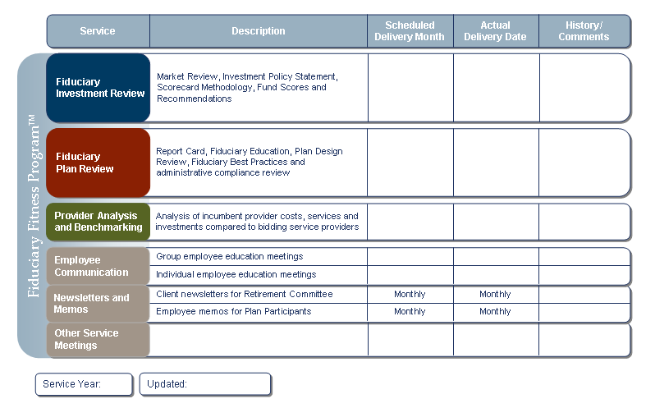
Documented Service Plan: Your Road Map
At the start of each relationship we set goals and objectives via a written Service Plan. We then track the timing and frequency of each service delivered and post all deliverables on our secure plan sponsor portal.
Notes:
PROACTIVE SERVICE PLAN
Goals / Objectives
Track Services - Progress

Slide 14
^{Fiduciary Diagnostic™}
Plan Sponsor Fiduciary Compliance
Guidance
DOCUMENTATION
DIAGNOSTIC
ACTION
PLAN
EDUCATION
Advice
Fiduciary Guidance & Assurance

Slide 15
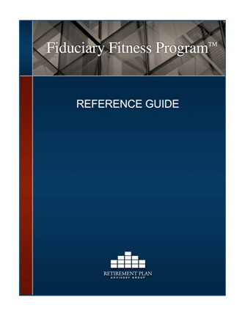
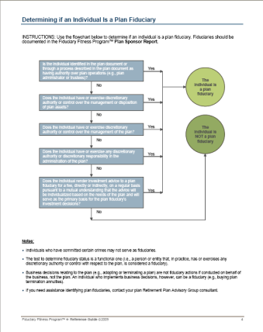
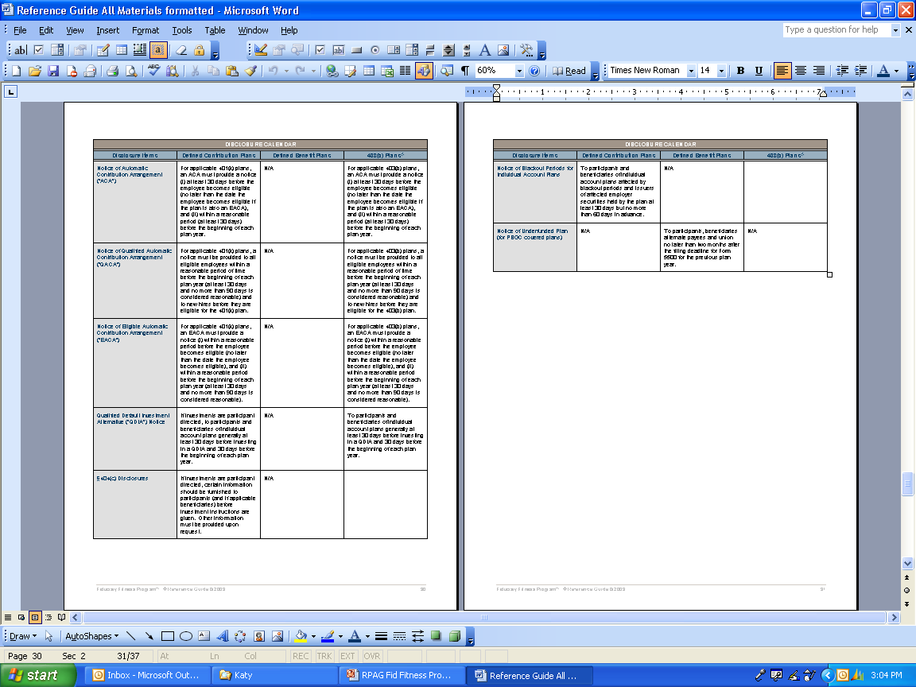
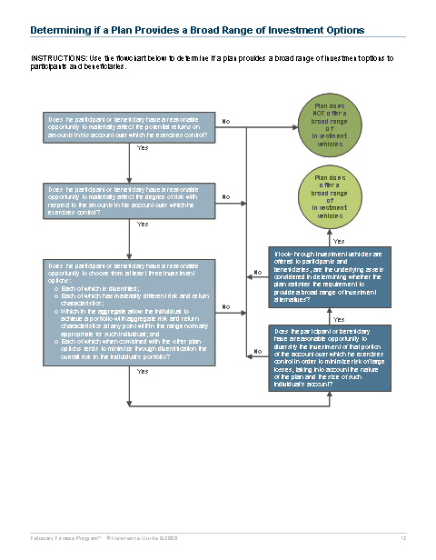
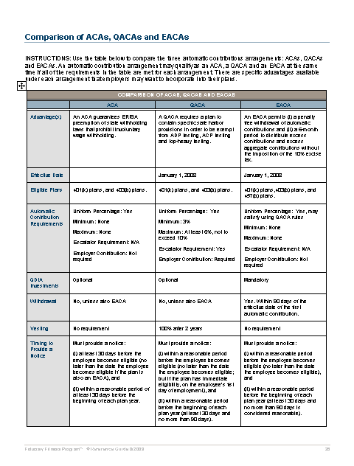
Reference Guide
Plan Sponsor Fiduciary Compliance
Plan Sponsor Reference Guides
  Flow charts
  Checklists
  Sample responses
Fiduciary Reports for addressing day-to-day fiduciary questions
Notes:
Flow Charts
Checklists

Slide 16

^{ERISA Guidance & Support}
Plan Sponsor Fiduciary Compliance
Navigating today’s ever-changing and increasingly complex legal and fiduciary compliance landscape can be challenging.
Our goal is to provide competent access to ERISA guidance.
ERISA Attorney access
Regulatory and legislative changes
Relevant litigation developments
IRS and DOL audits
Annual audit assistance
Client advocacy

Slide 17
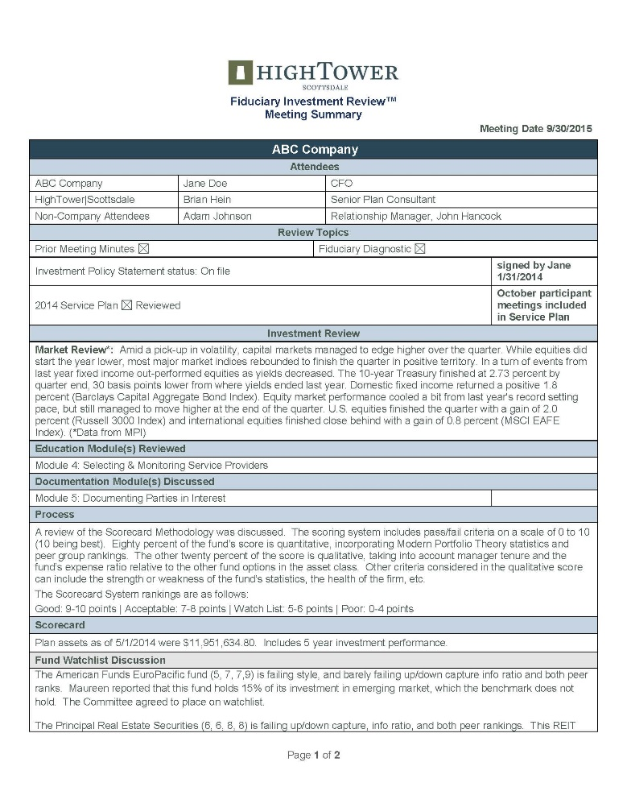



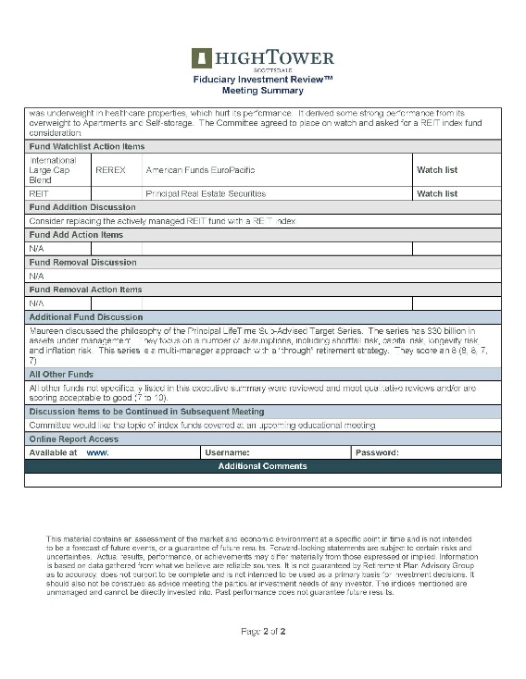
Documentation
Plan Sponsor Fiduciary Compliance
Everything required for compliance including:
Investment committee charter
Investment policy statement
Investment monitoring reports
Fee benchmarking reports
Fiduciary compliance checklist
Fiduciary file checklist
Required notices and disclosures
Meeting minutes
Notes:
Meeting Minutes

Slide 18
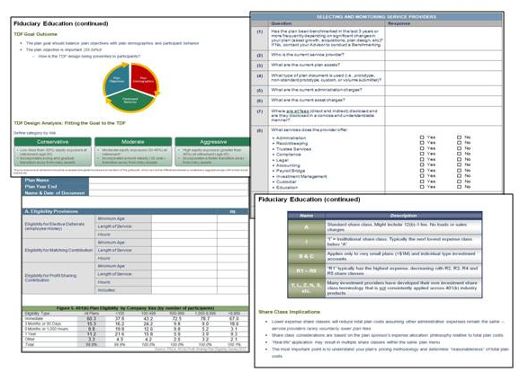
Fiduciary Fitness Program
Plan Sponsor Fiduciary Compliance
BEST PRACTICES APPROACH
Compliance Program offers a holistic approach to fiduciary best practices.
Provides resources to help identify potential plan weaknesses and remedy those weaknesses through education, diligence and improved processes:
Fiduciary Diagnostic™: Demonstrates what
plan sponsors and fiduciaries need to
address and documents plan management
responsibilities
Fiduciary Plan Review™: Examines plan
design and documents prudent processes
Education Modules: Contain 20+ education
modules on topics from fiduciary
responsibilities to employer securities,
real property, and mergers and acquisitions
Documentation Modules: Create positive
evidence that fiduciaries’ activities meet
their responsibilities under ERISA and the Internal Revenue Code

Slide 19
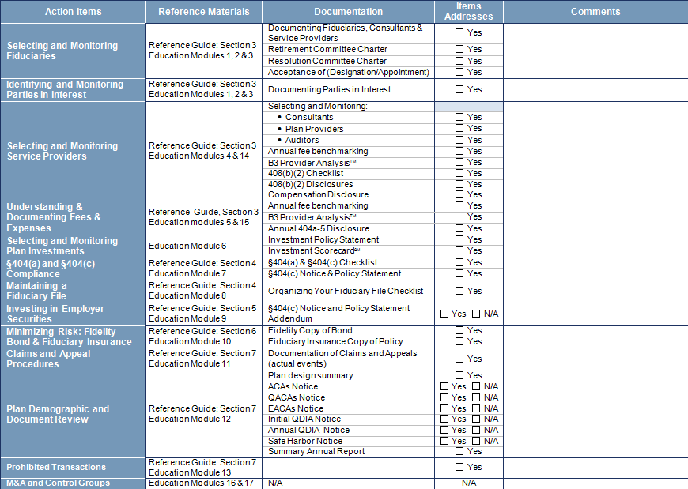
Fiduciary Diagnostic™
Plan Sponsor Fiduciary Compliance
Fiduciary Report Card™ Checklist
Periodic compliance gap analysis
Ensures everything is in order for safe and secure operation
Covers hundreds of fiduciary requirements in 20+ separate education modules
Notes:
Fiduciary Gap Analysis
Fiduciary Road Map

Slide 20

Fiduciary Education Modules
Plan Sponsor Fiduciary Compliance
Fiduciary Education Modules provide resources to inform committee members regarding ERISA’s fiduciary requirements.
Fiduciary Overview | Maintaining Your Fiduciary File | 404a-5 Disclosure Regulations
Fiduciary Responsibilities | Investing in Employer Securities | Controlled Groups
Fiduciary Liabilities | Minimizing Risk Strategies | Mergers & Acquisitions
Selecting Service Providers | Claims & Appeals Procedures | Timely Deposits
Fees & Expenses | Participant Experience | Elective Contributions
Selecting Investments | Prohibited Transactions | TDF Selection
ERISA 404(a) & 404(c) | 408(b)(2) Disclosure Regulations | DOMA
Notes:
Fiduciary Compliance
Who helps you to understand your fiduciary and plan management responsibilities under ERISA?
Who helps you to document your plan’s fiduciary processes, discussions and actions taken?
Who helps you to document that required tasks are completed?
Initially, we will conduct a Fiduciary Diagnostic on your plan that will be used to identify any existing gaps pertaining to your committee’s fiduciary responsibilities. Your plan’s Fiduciary Diagnostic is then reviewed and updated on a regular basis to identify upcoming plan management responsibilities and to document when required tasks are completed. Our Fiduciary Education Modules provide resources to inform and educate committee members regarding ERISA’s fiduciary requirements

Slide 21
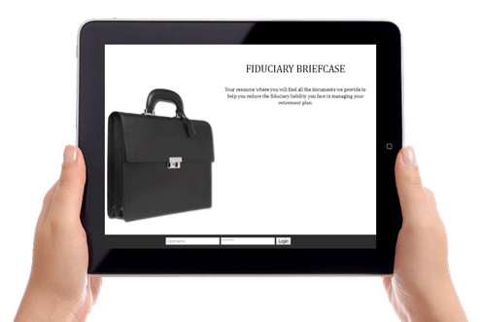
Fiduciary Electronic File Cabinet (Briefcase™)
Plan Sponsor Fiduciary Compliance
Online, cloud-based, electronic file storage system provides 24/7 access to all your important fiduciary documents.
Plan documents
Committee charter
Investment policy statement
Meeting minutes
Investment monitoring reports
Fee benchmarking studies
Required disclosures and notices
/ compliance documentation
Participant education materials
Newsletters
Notes:
Online Fiduciary Audit File System

Slide 22
^{Investment Analysis}
Choosing and monitoring the appropriate investments offered in your plan is a serious fiduciary task, as it can impact a participant’s retirement experience.
Intelligence Driven Advisers provides independent investment analysis to assist you with this important responsibility.

Slide 23


Investment Policy Statement
An institutional process which is comprehensive, independent, and a well-documented methodology to provide continuity.
Powered by
Quantitative
Metrics
Investment
Universe
(20,000+ investments)
Investment
Policy
Statement
=
Investment Menu
+
Qualitative
Metrics

Slide 24
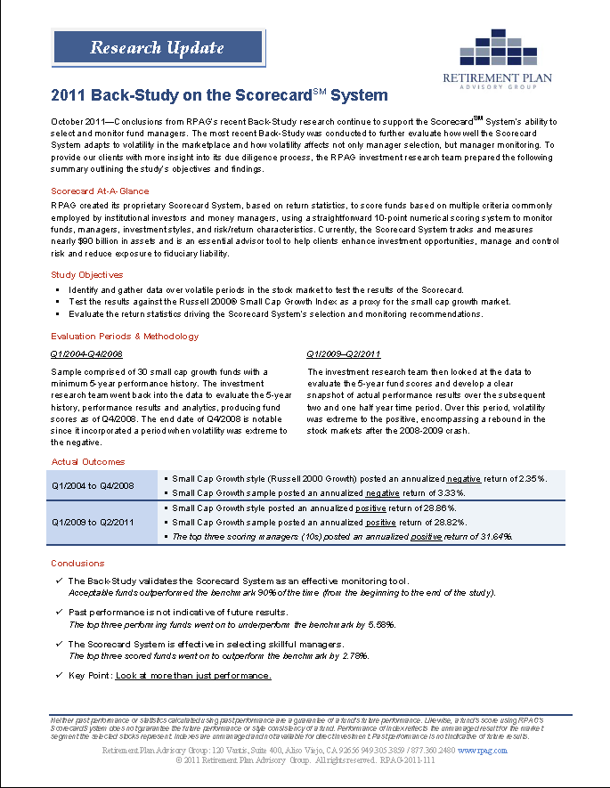
Back Test
FUND EVALUATION
The Back-Study validates the Scorecard System as an effective monitoring tool.
Acceptable funds outperformed the benchmark 90% of the time (from the beginning to the end of the study).
Past performance is not indicative of future results.
As an example, the top three performing funds in the asset class universe went on to underperform the benchmark by 5.58%.
The Scorecard System is effective in selecting skillful managers.
In comparison the top three Scorecard SystemSM scored funds went on to outperform the benchmark by 2.78%.
Key Point: Look at more than just performance.

Slide 25
Scorecard – Evaluation Criteria
  The ScorecardSM ranking evaluates investments on a scale of 0 to 10 in core asset classes, including asset allocation investments.
Qualitative Factors
Quantitative Factors
30%
Style Factors
30% Risk/Return
Factors
20% Peer Group Ranking
20% Qualitative Ranking
1. Style Analysis
2. Style Drift
3. R-Squared
4. Risk/Return
5. Up/Down Capture
6. Information Ratio
7. Returns
8. Information Ratio
9 &10. Awarded for factors as Manager Tenure
and fund expenses, among other criteria

Slide 26
Breakdown of Investment Fees
12b-1:
Paid by mutual funds from fund assets for broker commissions, marketing expenses and other administrative services.
Investment Management:
A percentage of assets invested.
Deducted from the return.
12b-1 Fees
Shareholder Servicing: Revenue shared by the mutual fund company with the service provider.
Investment
Management Fee
Shareholder
Servicing Fees
Sub-TA
(Agency
Transfer Fees)
Sub-TA:
Recordkeeping and other services related to participant shares often go to a third party called a sub-transfer agent.
Asset / Wrap Fee:
Additional fees layered on top of total investment fees.
The above listed fees may not apply to all investments. Check the prospectus or fact sheet to determine what fees are being charged.

Slide 27
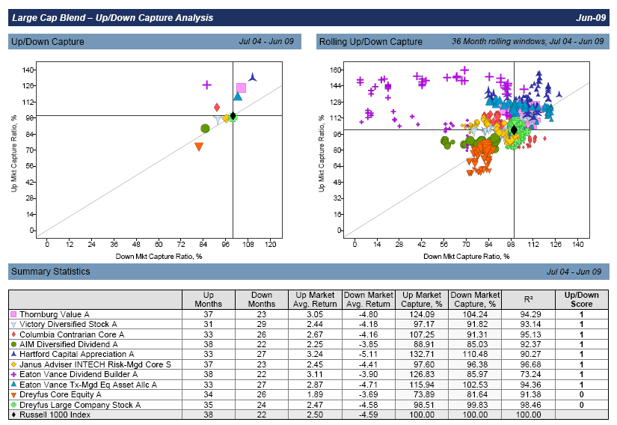
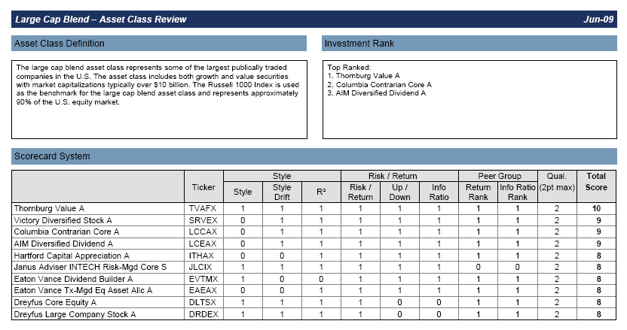
Independent Investment Due Diligence
The Fiduciary Investment Review includes recommendations for fund additions, deletions and replacements
Sample Scorecard Report Excerpts
Scorecard Point System
Good 9-10 Points
Acceptable 7-8 Points
Watch List 5-6 Points
Poor 0-4 Points
Notes:
Independent - PROACTIVE
Additions
Deletions
Replacement

Slide 28
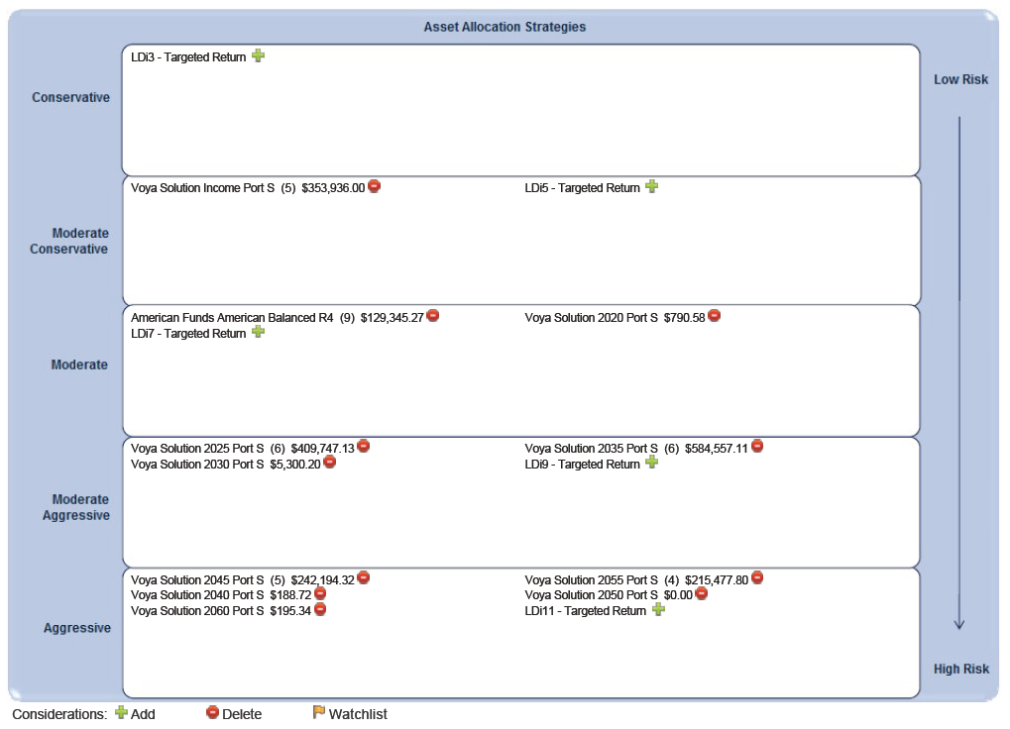
Style Box – Asset Allocation Strategies (Sample)

Slide 29
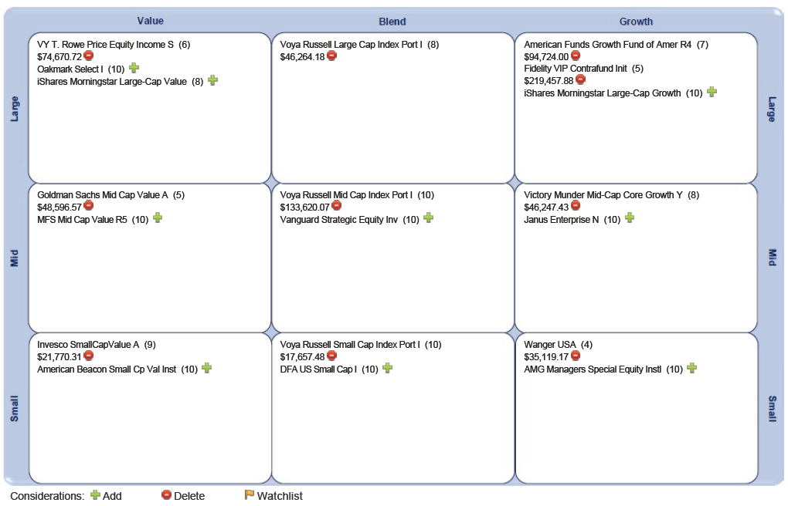
Style Box – Domestic Equity (Sample)

Slide 30
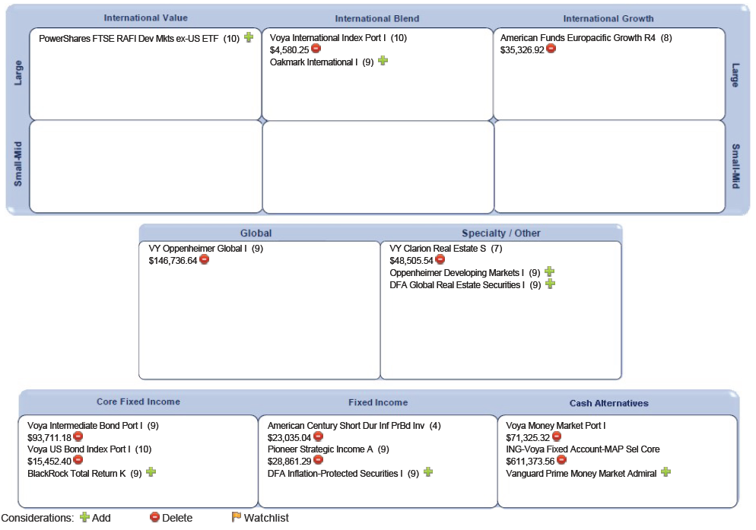
Style Box – Intl Equity, Fixed Income & Specialty (Sample)

Slide 31
^{Investment Implementation}
“Do It For Me (DIFM) or Do It Myself (DIM).
Leadership Driven Advisers provides investment choices to assist Participants with this important responsibility.”

Slide 32




Investment Implementation Options
Participant Investment Implementation
401(k)

Slide 33
Investment Options
Core Mutual Fund Menu - Create your own custom allocation from the “core” menu of mutual funds
Target Date Funds (TDF) – Select the Target Date Fund that is closest to your target retirement year
ijoin Managed Account Program (MAP) – Personalized retirement funding strategy based on income, savings, outside assets, residency, age and other factors.
    Note: either TDF or MAP can be set as the default investment if participants do not make an investment selection
Notes:
Review how the investment selection is determined

Slide 34

Investment Options
ijoin Managed Account Program (MAP) – Personalized retirement funding strategy based on income, savings, outside assets, residency, age and other factors.
ijoin Video
    Note: either TDF or MAP can be set as the default investment if participants do not make an investment selection
Notes:
Review how the investment selection is determined

Slide 35
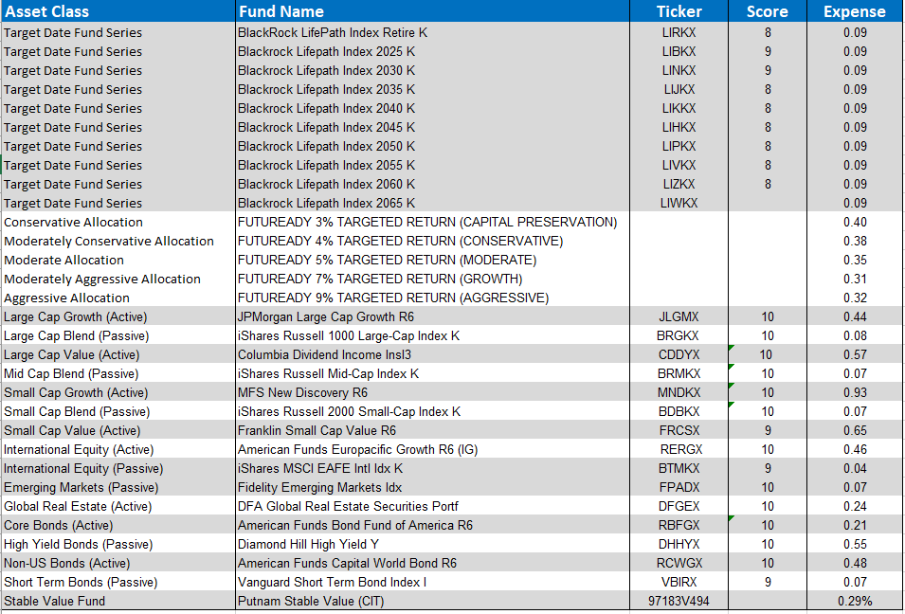
“Do It For Me” (DIFM) and “Do It Myself” (DIM)” Solutions
Retirement
Date Based
Goals-Based
Approach
Self
Managed

Slide 36
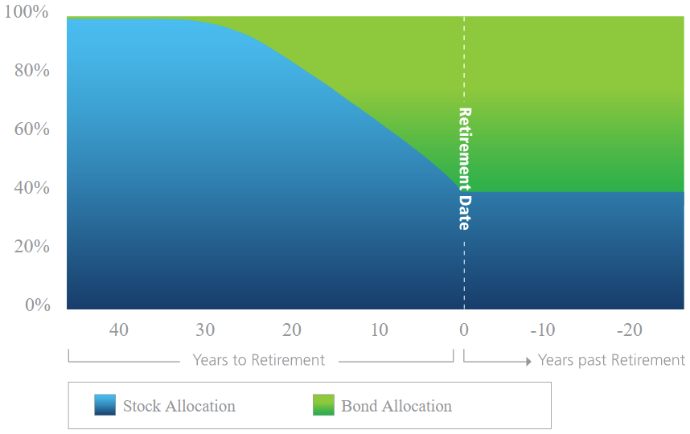
Target Date Funds
(Do It For Me” - Retirement DATE-based approach
Retirement date-based portfolio designed to take you “to” retirement.
Designed to navigate 4 retirement concerns:
  Market Risk (volatility)
  Longevity Risk (outliving your $$)
  Inflation Risk (reduction of purchasing power)
  Behavioral Risk (making emotional mistakes)
Investment mix is designed to become more conservative as you near retirement date.
Underlying portfolio is constructed of low-cost index funds.
Glidepath sets the appropriate level of risk at the retirement date to minimize the chance of outliving your savings.
Seeks to reduce volatility allowing you to remain invested in the same fund in the years leading up to retirement.
Notes:
We believe a common sense case can be made for the “to fund” approach based on an understanding of human capital, or the ability to earn income, which is depleted at retirement. We argue that Retirement risk is at its highest level the day retirement begins given your capital should be at its lifetime peak. Losses not have the greatest impact on your ability to sustain spending throughout your retirement. (iJoin addresses this as well). Blackrock whitepaper.

Slide 37
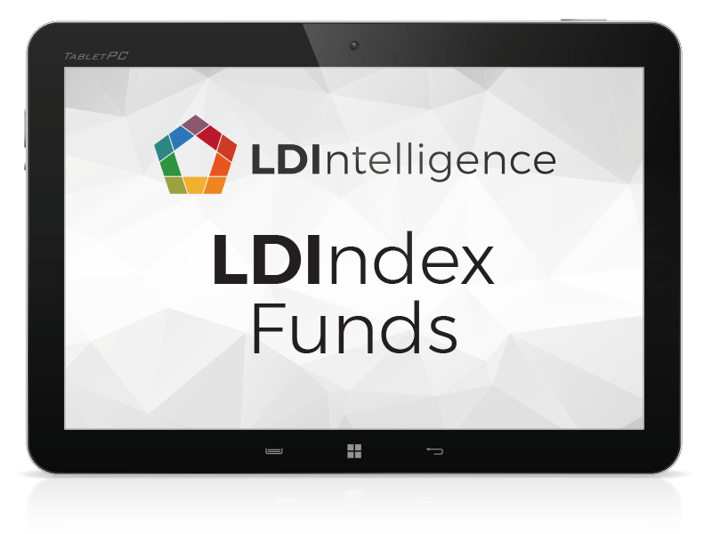
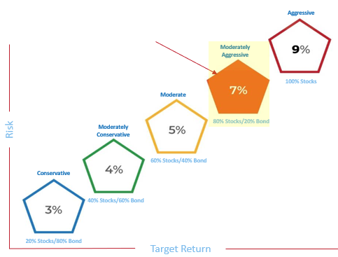
Target Return Portfolios
“Do It For Me” - GOALS-Based Approach
Managed Account Programs (MAP)
MAP’s easy 3-step process:
Assessment of Participant’s Circumstances
Recommends – Most Suitable Target Return Funds
Illustrates Paycheck Ramification / Future Retirement Income Forecasts
Features / Benefits:
Automated based on existing Participant data
Option to add external data through ENROLL
Addresses the following initiatives:
Managed Account Program

Slide 38
Target Return Portfolios
“Do It For Me” - GOALS-Based Approach
Addressing Different Portfolio Needs
Participant A
Goal: Retirement Income Security
Age: 35
Retires: 67
Salary: $60,000
Deferrals: $5k annually
ASSETS: $75,000
Participant B
Goal: Retirement Income Security
Age: 35
Retires: 67
Salary: $60,000
Deferrals: $5k annually
ASSETS: $5,000
Defensive Capital Preservation
Maximum Capital Appreciation
Target Return 3%
Capital Appreciation / Income
Target Return 8%
Equity Target 15%
Target Return 5%
Equity Target 90%
Equity Range 5-35%
Purchasing Power Preservation
Equity Range 75-95%
Equity Target 60%
Capital Appreciation
Target Return 4%
Equity Range 45-75%
Target Return 7%
Equity Target 75%
Equity Target 40%
Equity Target 75%
Equity Range 25-55%
Equity Range 65-85%
Sample: Illustration Purposes Only
Allocation Ranges Will Vary Dependent Upon Capital Market Conditions

Slide 39
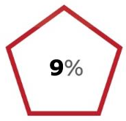
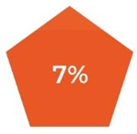
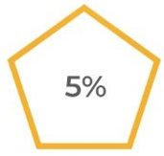
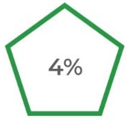
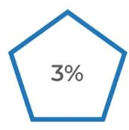
Target Return Portfolios
“Do It For Me” - GOALS-Based Approach
Aggressive
Your current Fund is Target Return 7%.
Moderately
Aggressive
100% Stocks
Moderate
Risk
Moderately
Conservative
80% Stocks/20% Bond
60% Stocks/40% Bond
Conservative
40% Stocks/60% Bond
20% Stocks/80% Bond
Target Return

Slide 40
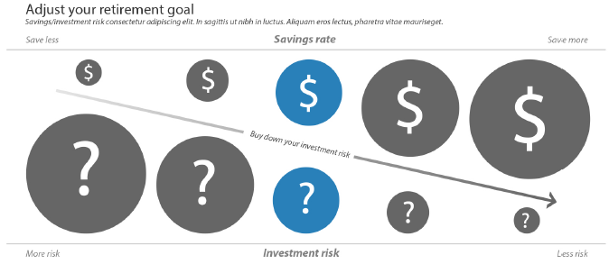
Savings / Investment Risk Tradeoff
Target Return Portfolios
“Do It For Me” - GOALS-Based Approach

Slide 41
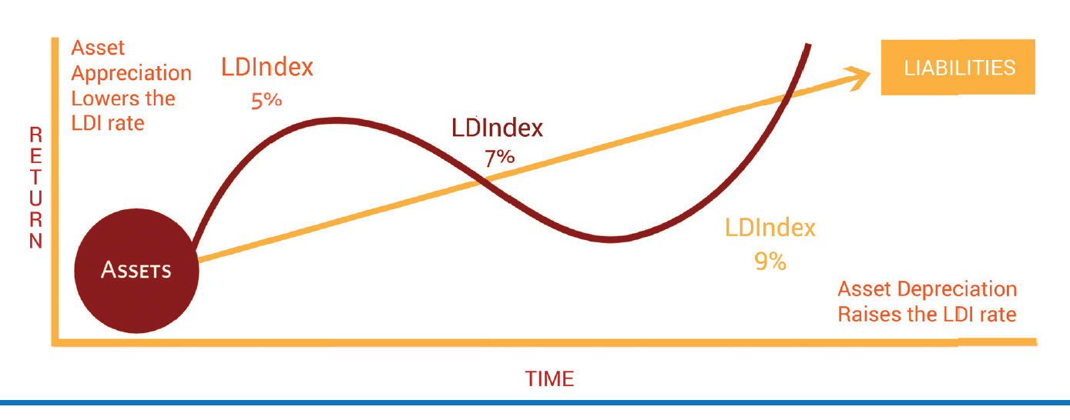
Asset Liability Investing (LDI) Approach
(not a set it and forget exercise, but automated for you)
FUTUREADY
5%
FUTUREADY
7%
FUTUREADY
9%

Slide 42
^{Education, Communication &}
^{Financial Wellness}
LDI Advisers delivers proactive consulting solutions that are comprehensive, compelling and technically proficient.
As a result, Participants are better informed about asset allocation, risk tolerance, and most importantly, better prepared for retirement.
Notes:
IMPROVE PARTCIPANT OUTCOMES
PROCESS FOR DOING A RETIREMENT NEEDS ANALYSIS
ECONOMIC REALITY – WHY WE DO WHAT WE DO
VIDEO

Slide 43
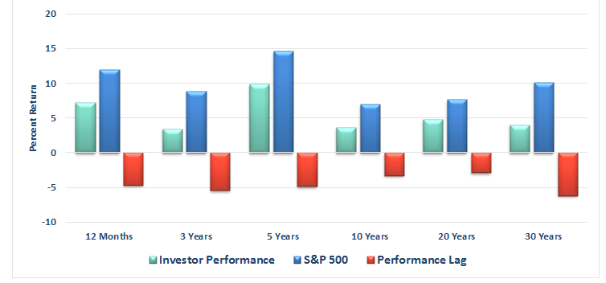
Investor Challenges
33% have saved more than $100,000 for retirement
33% of Participants over age 55 have less than $25,000 in retirement savings
54% of all Participants have not done a retirement needs calculation
The average Investor has dramatically underperformed in absence of advice
Investor Performance over time
Average Annual Return (as of 12/31/16).
Source DALBAR
8.21%
2.74%
3.17%
Notes:
RETIREMENT NEEDS CALCULATION:
VIDEO – Retirement Education

Slide 44
The Need for Financial Wellness
Financial stress impacts individual health, quality of life and productivity in the workplace.
Broke is the New Normal
70% of Americans live paycheck to paycheck;
64% can’t cover a $1,000 emergency without borrowing.³
Take Action
Employees recognize the value of taking action.
53% of employees want access to debt elimination or consolidation tools.¹
70%
53%
A Big Distraction
25% workers report that financial stress distracts them from work.²
25%
Our Financial Wellness Programs
    Financial Wellness Programs use behavioral economics to engage participants, educate them and get them to follow simple steps to reduce their debt, create budgets and begin to save more for retirement.
¹New Your Life Retirement Plan Services, 2014 Financial Stress Survey.
²PwC Employee Wellness Survey, 2013
³Ramsey Solutions SmartDollar Program

Slide 45
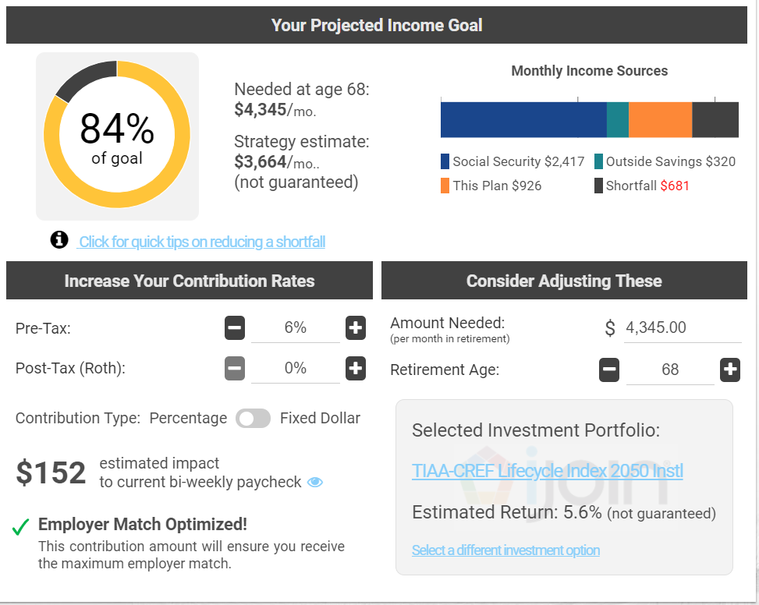
iJoin ENROLL & MAP
Automated Participant Engagement
Real time modeling of:
Retirement Income
Retirement Gap
Contribution Rate Changes
Impact to Current Pay
Match Optimization
Social Security Estimates
Effect of Retirement Age
Effect of Outside Assets

Slide 46
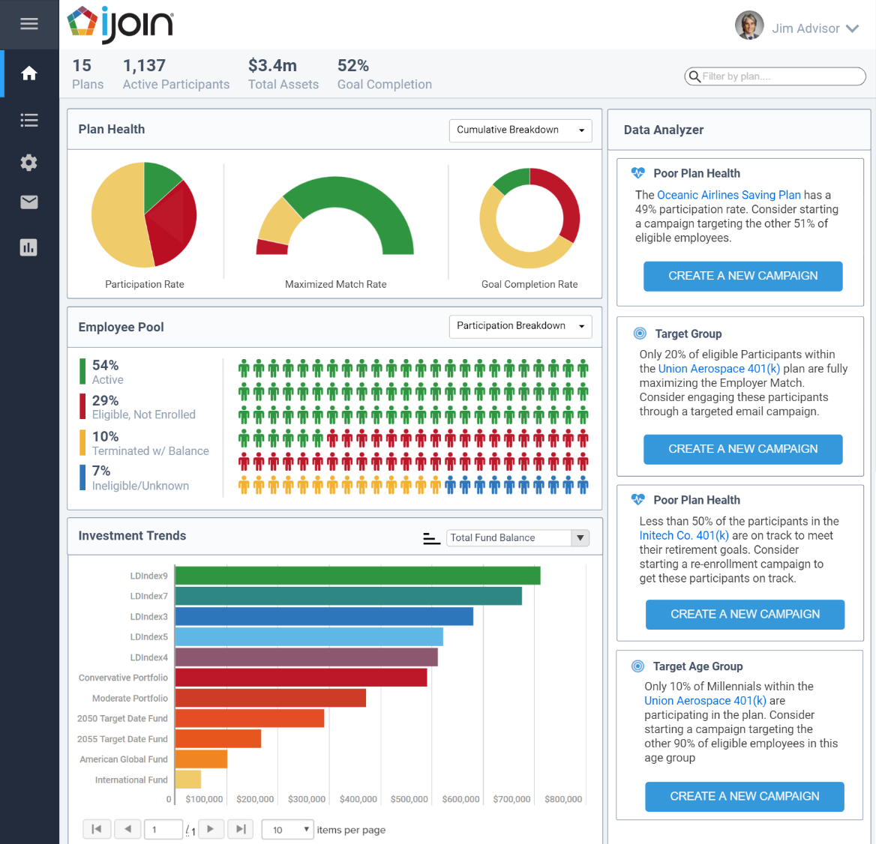
iJoin ENROLL & MAP
Automated Plan Advisor / Plan Sponsor Engagement
iJoin ACT
modeling of:
Rate Changes
Actionable Analytics per:
Advisor’s Book
Plan
Participant
Enact targeted messaging campaigns
Benchmark retirement readiness metrics

Slide 47
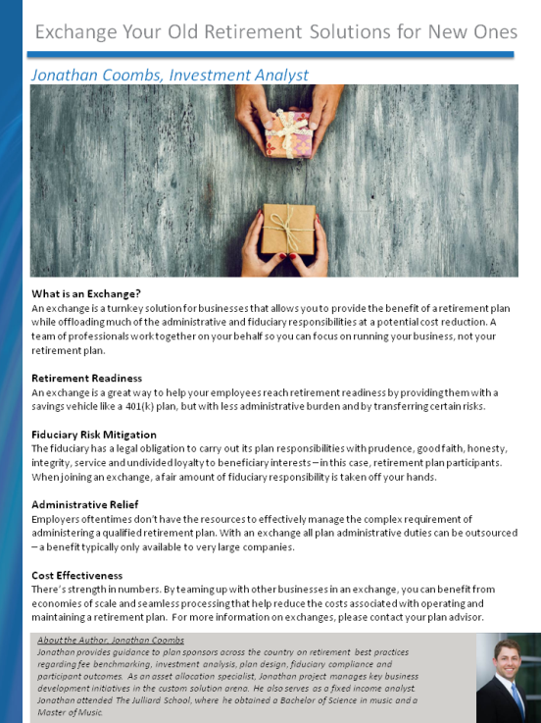
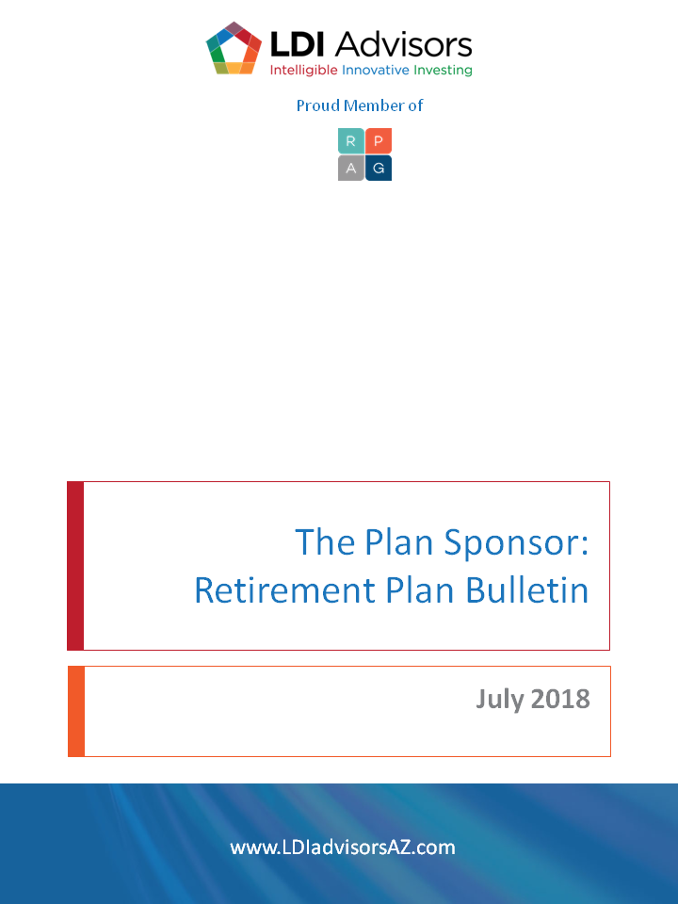

Newsletters and Employee Memos
Monthly Plan Sponsor Newsletters keep abreast on the latest retirement plan news, legislative updates, and industry trends
Employee Memos that you can print and distribute to employees
Targeted Education Campaigns based on segmented Participant demographics (i.e., employee match optimization, catch-up candidates, etc.)
Sample Plan Sponsor Newsletter
Notes:
Newsletter designed to answer your questions
Sample employee communications

Slide 48
Participant Education Services
Group and Individual Education Meetings
Employee Communication Strategies
Maximizes Communications for Plan Participants!
Asset Allocation and Investment Guidance
Goals Based Investing – iJoin Engagement
Investing Webinars
Education Modules & Employee Memos
Notes:
Participant Guidance:
Education or
Advice

Slide 49
Fee Benchmarking and Vendor Searches
Benchmarking plan provider services, investment opportunities and total plan fees can overwhelm even the most diligent plan sponsor.
We shoulder the responsibility of thorough market analysis, offering guidance and support throughout the process.
Notes:
What did you do to meet your 408(b)(2) fee disclosure obligation?
Fair and Reasonable
Necessary

Slide 50
Benchmarking Services
Meaningful benchmarking of a provider’s services requires equal emphasis on the cost and quality aspects of provider services
Fees
Investments
Services

Slide 51
Report Components
Comprehensive Report includes 400+ Data Points balancing services, investments and fees
Side by Side comparison for a thorough perspective
Employs Quantitative and Qualitative metrics
Recordkeeping
Costs
Technology
Services
Retirement
Plan
Investment
Management
Employee
Communications
Compliance
Notes:
400 Data points
Side by Side comparison

Slide 52
Plan and Provider Considerations
Our RFP approach helps ensure that apple-to-apple comparisons are used throughout the benchmarking process.
Size and Complexity
Demographic Match
Service Requirements
Plan
Provider
  Strengths and Experience
Investment Needs
  Systems
  Capabilities
Notes:
You have to also balance both the plan and provider considerations when conducting a benchmarking study.
For the plan, you need to look at the plan’s size and complexity, service requirements and investment needs.
For the provider, there must be a demographics match, you need to evaluate their strengths and experience in the marketplace, and ensure that their system capabilities will work with your plan design.

Slide 53
Benchmarking Approaches
Average-fee benchmarking is based on average plan design and average demographics.
Versus
Live-bid (real-time) benchmarking is based on your plan design and your demographics.
Average
Represents 25 to 40% of plan costs
Live Bid
fees
RPAG benchmarking universe
$500 Billion in qualified plan assets.
20,000+ qualified plans
plan assets

Slide 54


Value Relative to Services Rendered
PLAN SPONSORS
PARTICIPANTS
Protecting Yourself as a Responsible Plan Fiduciary
Helping Your Participants Retire
Notes:
54

Slide 55
^{Closing}
LDI Advisers helps to protect plan fiduciaries from liability, while enhancing investment opportunities and helping participants achieve financial security.
LDI’s Commitment to excellence.

Slide 56
Service Model Overview
Participant Outcomes
Fiduciary Compliance
Helping participants pursue retirement income potential
Target Date Suitability
Providing assurance for fiduciaries
Investment Advice
Identify the LDIndex Targeted Return Portfolio for your participants
Benchmarking
Selecting skilled investment managers
Plan
Design
Balancing provider fees, services & investments
Creating plan design consistent
with company philosophy

Slide 57
Consider 3(38) Consulting Services

Slide 58
Disclaimer
Advisory services offered through NewEdge Advisors, LLC, a registered investment adviser.
THIS PRESENTATION IS FOR INFORMATION AND DISCUSSION PURPOSES ONLY, AND IS NOT AN OFFER TO SELL OR A SOLICITATION OF OFFERS TO BUY SECURITIES OR TO MAKE ANY INVESTMENT DECISION OF ANY TYPE. THE INFORMATION IN THIS PRESENTATION IS INTENDED FOR ILLUSTRATIVE AND DISCUSSION PURPOSES ONLY, AND IS NOT TO BE RELIED UPON FOR ANY INVESTMENT DECISION OR FOR ANY OTHER PURPOSE. THIS PRESENTATION HAS NOT BEEN FILED WITH OR APPROVED BY ANY SECURITIES AUTHORITY NOR HAS ANY SUCH AUTHORITY PASSED UPON THE ACCURACY OR ADEQUACY OF THIS PRESENTATION OR ANY INTEREST IN THE COMPANY.
THE COMPANY MAKES NO EXPRESS OR IMPLIED REPRESENTATION OR WARRANTY AS TO THE ACCURACY OR COMPLETENESS OF THIS PRESENTATION. THIS PRESENTATION IS COMPRISED LARGELY OF FORWARD-LOOKING STATEMENTS AND INFORMATION THAT IS BASED ON THE BELIEFS OF THE COMPANY’S MANAGEMENT BASED ON INFORMATION CURRENTLY AVAILABLE. FORWARD LOOKING STATEMENTS INVOLVE RISKS AND UNCERTAINTIES THAT COULD CAUSE ACTUAL RESULTS, PERFORMANCE AND RETURNS TO DIFFER MATERIALLY FROM THE RESULTS PRESENTED IN THIS DOCUMENT, DUE TO A VARIETY OF FACTORS, RISKS AND UNCERTAINTIES, REGARDLESS OF WHETHER KNOWN OR NOT KNOWN TO US. EVEN IF THE RESULTS AND DEVELOPMENTS IN THIS PRESENTATION ARE REALIZED IN WHOLE OR IN PART, THERE IS NO ASSURANCE THAT THEY WILL HAVE THE EXPECTED CONSEQUENCES OR EFFECTS ON THE COMPANY OR ITS CONSTITUENTS. THIS PRESENTATION SPEAKS ONLY AS OF ITS ORIGINAL DATE OF PREPARATION AND DOES NOT PURPORT TO BE ALL THE INFORMATION AN INTERESTED PARTY MAY REQUIRE IN ORDER TO EVALUATE AN INVESTMENT IN OR OTHER RELATIONSHIP WITH THE COMPANY.
THIS PRESENTATION HAS BEEN SUBMITTED ON A CONFIDENTIAL BASIS TO YOU BASED ON YOUR QUALIFICATIONS AND YOUR EXPRESSED INTEREST IN LEARNING MORE ABOUT THE COMPANY AND SERVICES PRESENTED. YOU MAY NOT REPRODUCE, USE OR COPY THIS PRESENTATION IN ANY MANNER WITHOUT THE PRIOR WRITTEN CONSENT OF THE COMPANY. BY ACCEPTING THIS PRESENTATION, YOU AGREE TO HOLD THE INFORMATION IN STRICT CONFIDENCE AND WILL NOT USE ANY OF INFORMATION TO THE DETRIMENT OF THE COMPANY.
S:\Shared With Me\401(k) - Plan Services\Marketing, Presentation, Logos\Marketing-401k Presentations
Notes:
TPSU
TRAU - Certified 401(k) Specialist
Membership has it’s privileges – Advisory Board - Chatter Membership

