Slide 1


Slide 2
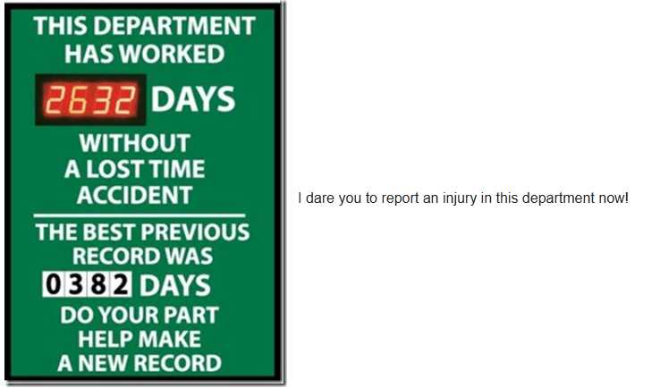
The golden window

Slide 3
The quality of the information degrades every hour after an injury.
Witnesses become more difficult to reach as time goes on
Treatment can be delayed
Recounting of the incident can be exaggerated by some and downplayed by others – even when discussing the same incident
The policy requires the employee to report the injury within THREE (3) days, and the employer has 30 days to get the claim to summit

Slide 4
The “Golden Window”
Do’s and don’ts
DO:
Submit the employer’s report of injury – even if you don’t have all of the information.
Ensure correct contact info has been provided. We try to make contact by phone within 24 hours of receiving the claim.
DON’T:
DELAY REPORTING – THIS COULD DELAY BENEFITS, OR EVEN PREVENT THE CLAIM FROM BEING ACCEPTED.
Hold onto the claim for a “full investigation.”

Slide 5
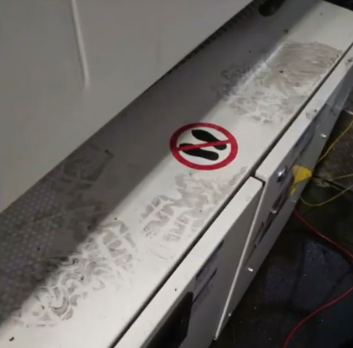
DOCUMENTATION & EVIDENCE
We can’t be certain of what happened…but there will be signs.

Slide 6
Documentation & Evidence
Do’s and don’ts
DO:
Document as many details as possible.
Send medical notes asap
Identify specific witnesses (names and numbers)
DON’T:
Speculate on legality/coverage
Refuse to allow a claim to be filed

Slide 7
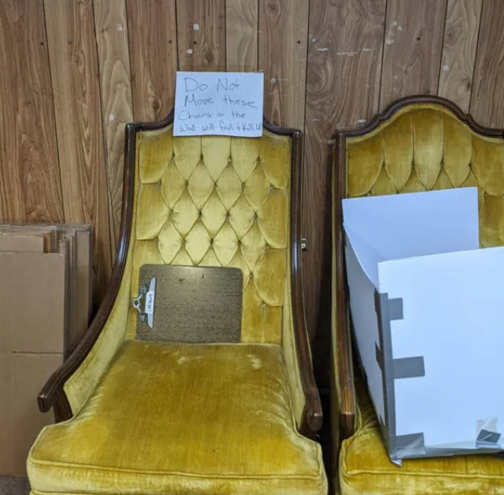
Communication & transparency

Slide 8
Communication & transparency
Do’s and don’ts
DO:
Report prior injuries/issues
Keep a “return-to-work” dialogue
DON’T:
“Ghost” us
expect someone else to provide information

Slide 9

Red flags & fraud prevention

Slide 10
Red flags & fraud prevention
Do’s and don’ts
DO:
Flag Monday morning reports
Note any behavioral changes
DON’T:
Accuse without proof
Avoid using the word “fraud” with the employee

Slide 11
The “done” list
To summarize:
Report the injury immediately
Verify the injured worker’s contact information (phone number and address) are correct
Document all relevant information
Continue communicating and additional information you receive or is requested by our office
Alert us of any red flags

Slide 12
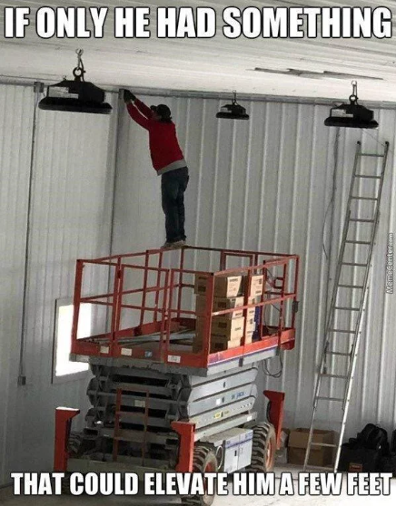
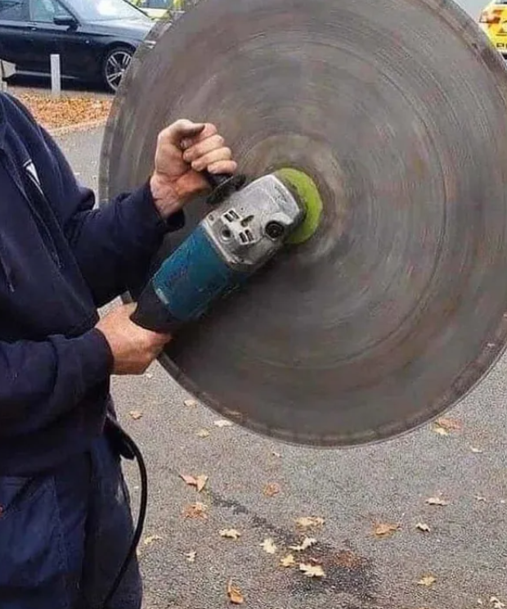

Slide 13
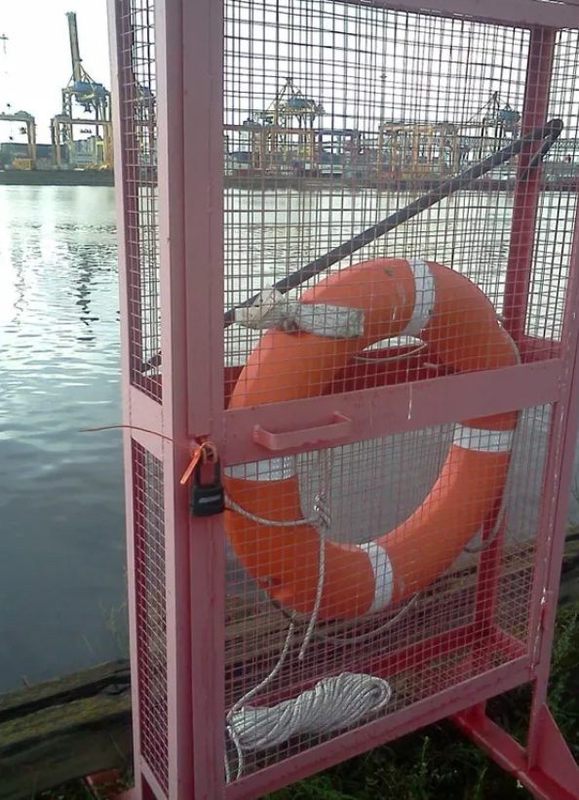
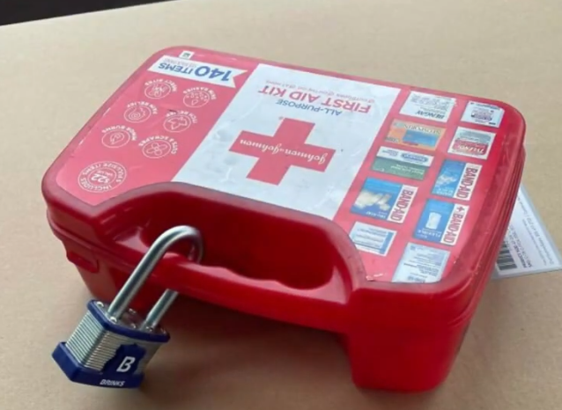

Slide 14
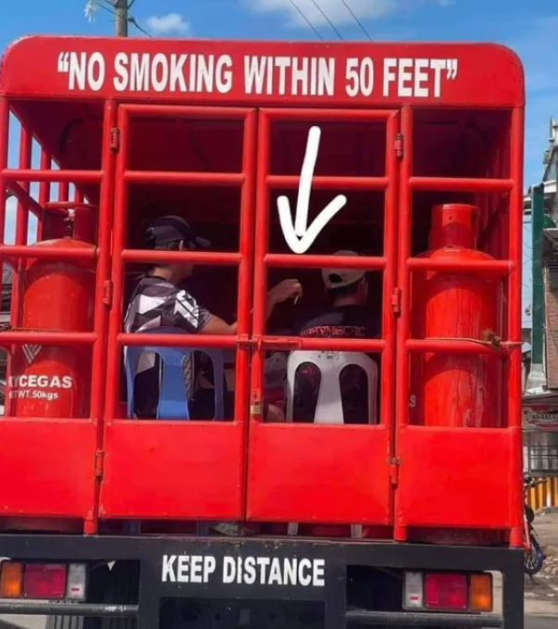
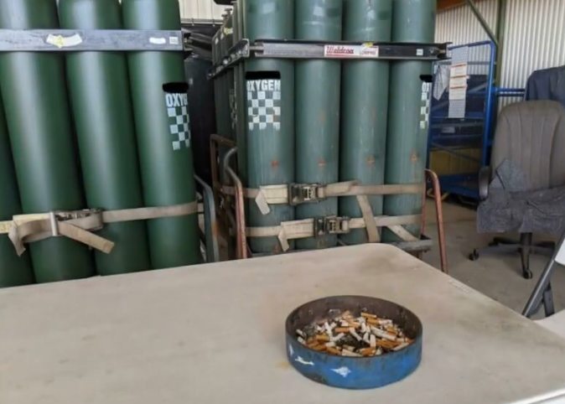

Slide 15
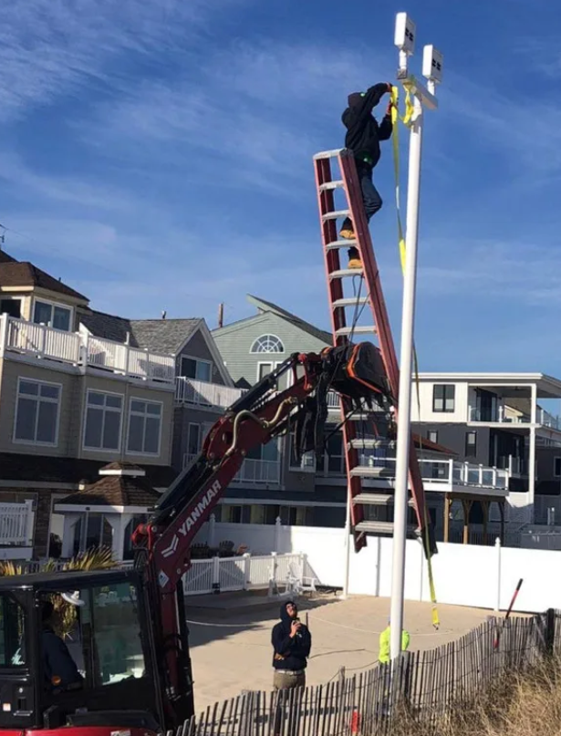
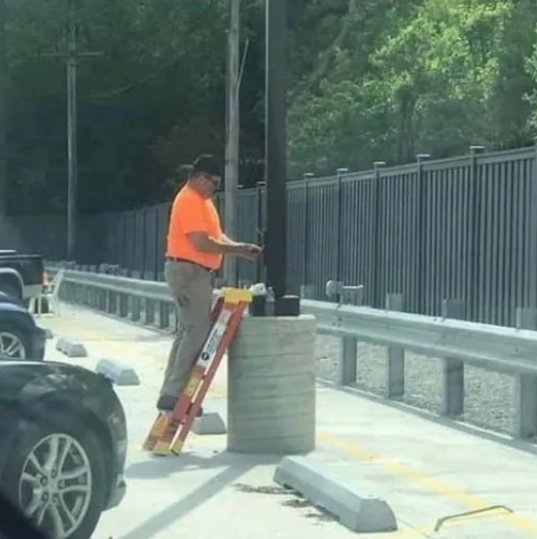

Slide 16
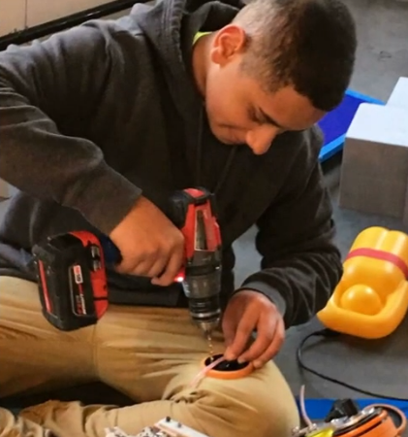
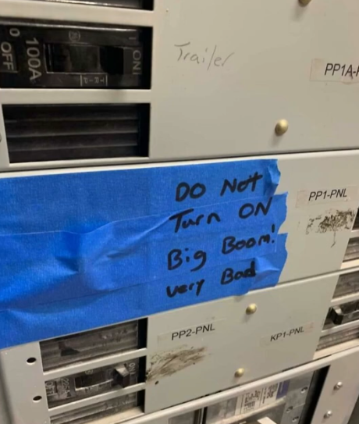
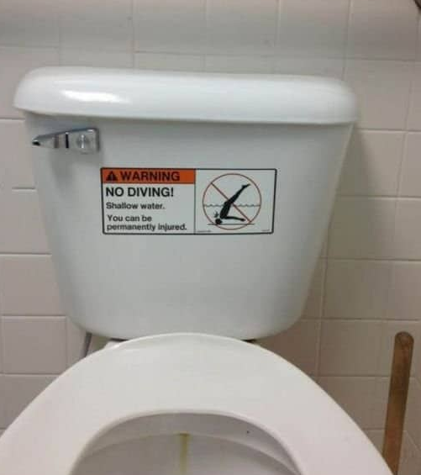

Slide 17
Questions?

